Slide 1
Journey of Integrated Tribal Area Development

Slide 2
Area of Intervention
Area = 3,087 km²
Population = 961,190

Slide 3
Initial Situations of the Area
Backward and drought prone area
Chronic water shortage in spite of 850-900 mm rainfall
High rate of soil erosion due to massive deforestation
Rainfed agriculture, short duration crops
Low rate of literacy
Poor health and hygiene practices
Substantial forced migration in search of livelihood
3

Slide 4
Program Initiatives
Initiatives
Community Development
Natural Resource Management
Agriculture & Horticulture development
Livelihood Enhancement
Education & Skill development
Agricultural Mechanization
Animal Husbandry
Community Health

Slide 5
Initiative I: Community/ Cadre Development
Community Based Organizations (CBO) approach
Capacity building of youth, women, farmers, cattle owners and adolescent girls, children, teachers
Established trained human resources (village level) to address their need based issues.
Active role of Women in economic and socio-political developments
Women led cooperative society formed in the area
1300 CBOs formed and nurtured, 150 village leaders have emerged as skill leaders for their village.
1416 village volunteers are trained in health and education awareness
5

Slide 6
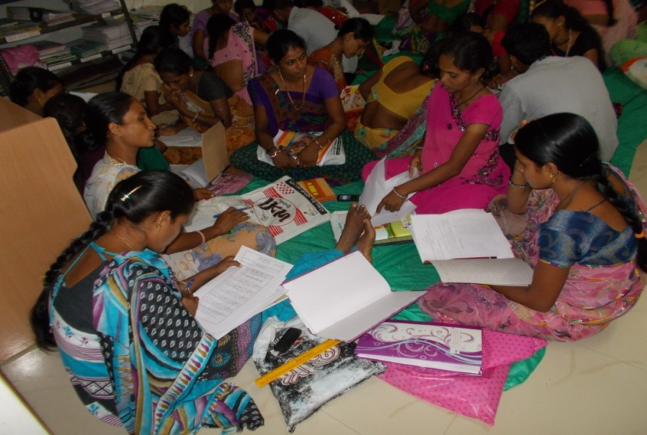
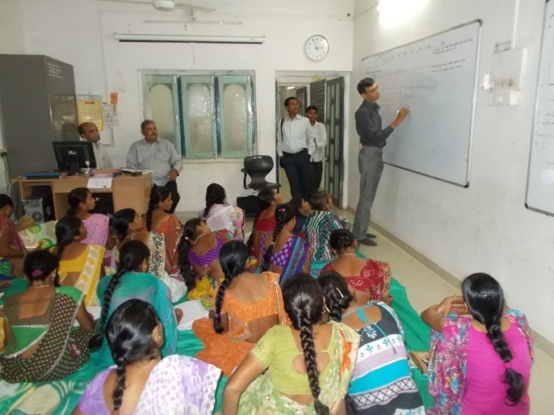
Impact of CBOs - Linkages
Sr. | Details | Total Beneficiaries Linked (HH)
1 | Agriculture | 3495
2 | Education | 722
3 | Health | 1831
4 | Housing and Household need | 9826
5 | Humanitarian (Social Protection) | 3524
6 | Income generation | 9538
7 | Village infrastructure | 623
8 | Water harvesting | 595
 | COVERAGE | 30518
6

Slide 7
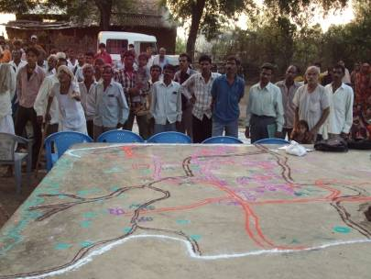
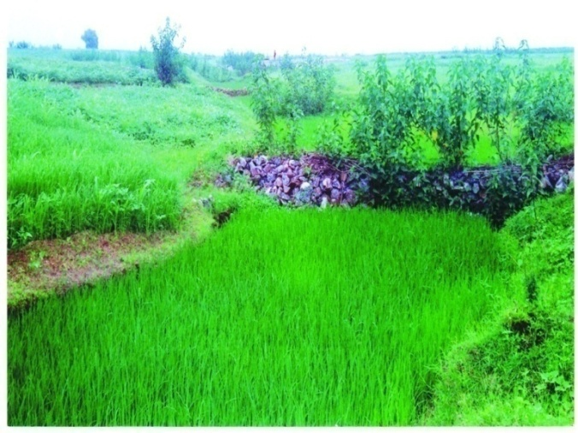
Initiative II: Watershed Area Development
Prepared Micro Plans with watershed management approach for 70 villages, with active participation of communities.
Impacts :
1,150 hectors land added for farming
Recharged 660 wells; water table up by 2-3 feet
Soil moisture holding capacity improved, opportunity for long duration crops
Drought proofing.
7

Slide 8
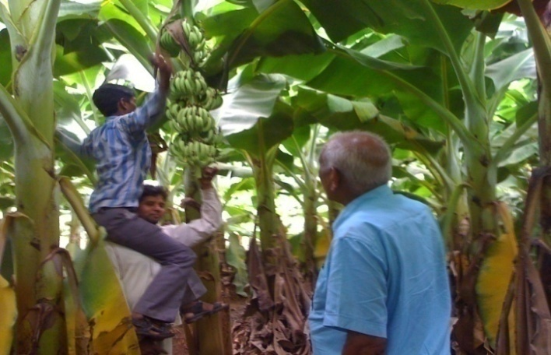
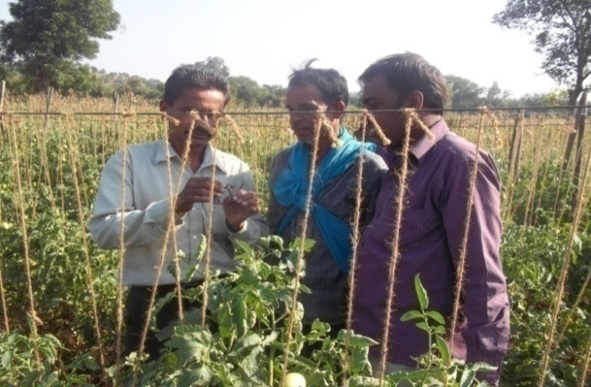
Initiative III: Agriculture & Horticulture Development
Technology transfer of Best Practices for different crops
Cold Storage and Value Addition (Ripening)
41250 farmers benefitted
Seasonal income increase by Rs.190 Million
8

Slide 9
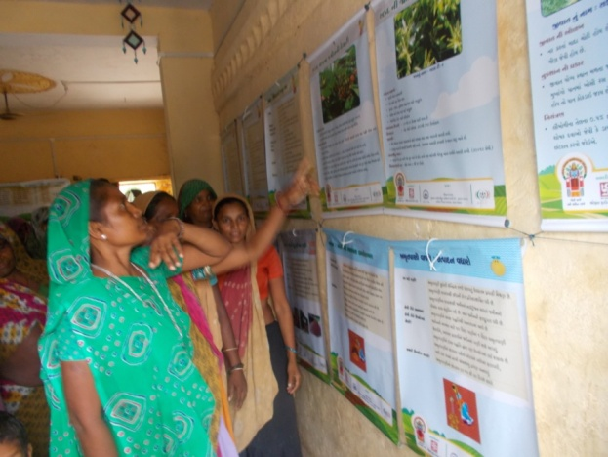
Farm Schools Knowledge Center at Farm Gate
Equipped with different training materials
Conducted 20000 training days for 7300+ women
72 Farm Schools as Knowledge and Resource Hub at village level
9

Slide 10
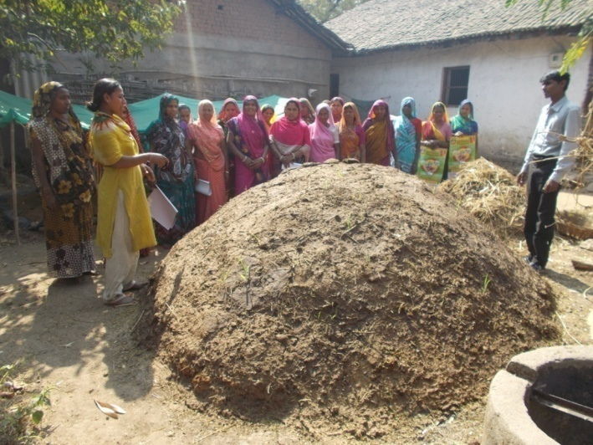
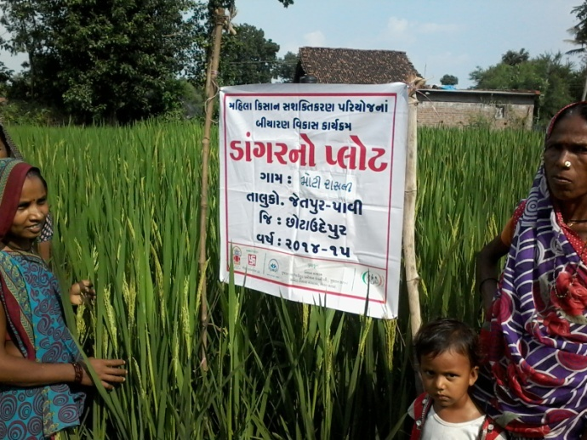
Soil Health Management (SHM) and Seed Security
3000 women farmers trained on concept of SHM
Provided training on Seed Security and Seed Preservation in 30 Villages through seed production plots
10

Slide 11
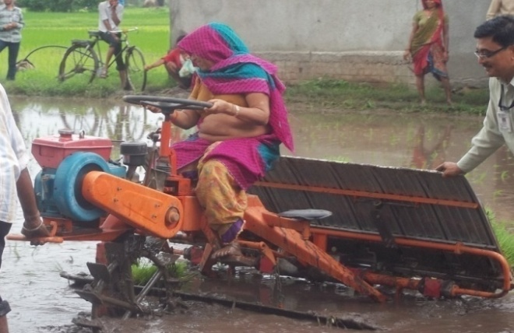
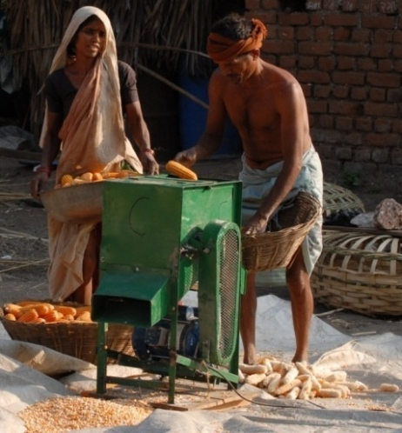
Initiative IV: Agri-Mechanization The way of Drudgery Reduction
Focused Drudgery Reduction in Agriculture
Agri Tool Bank for community with having improved farm tools
25 youths as Entrepreneurs (serving 100 villages)
12 Tribal Farmers’ Organizations covering 1635 farmers
Saved annual drudgeries of 42217 days in Agricultural operations.
11

