Slide 1
ENSURING FOOD SECURITY AND EFFECTIVE CLIMATE CHANGE MITIGATION THROUGH INTENSIVE COMMUNITY LED NRM INTERVENTIONS IN THE TRIBAL REGIONS OF WESTERN INDIA
Presentation By:
DR. KIRIT N SHELAT, IAS (RTD) Executive Chairman National Council for Climate Change Sustainable Development and Public Leadership (NCCSD) Email: drkiritshelat@gmail.com, Website: www.nccsdindia.org

Slide 2
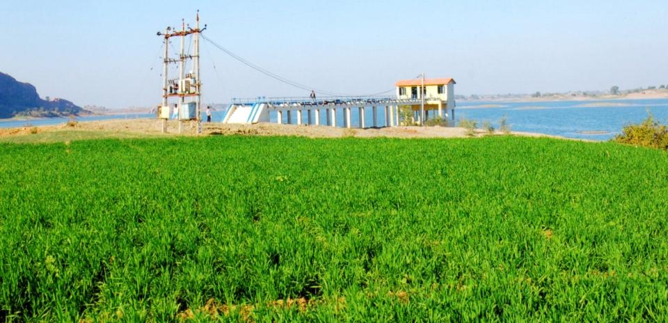
Water: Irrigation efficiency
Community Lift Irrigation Schemes
406 schemes covering 53,014 acres: 27,474 households

Slide 3
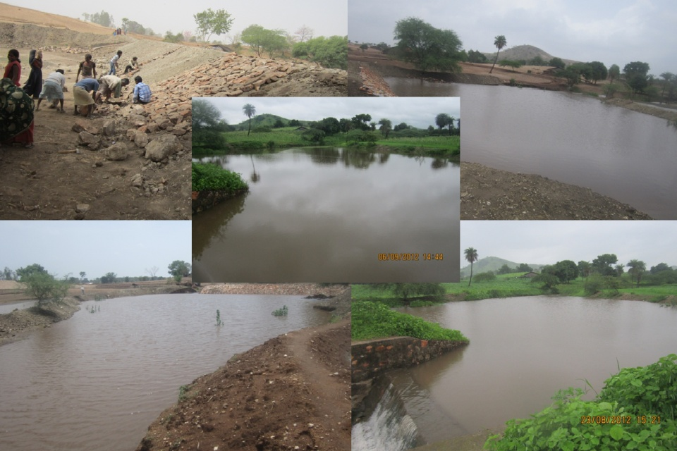
Soil and Water Conservation
Micro watershed area development
1,18,636 acres land treated
36,304 households benefited

Slide 4
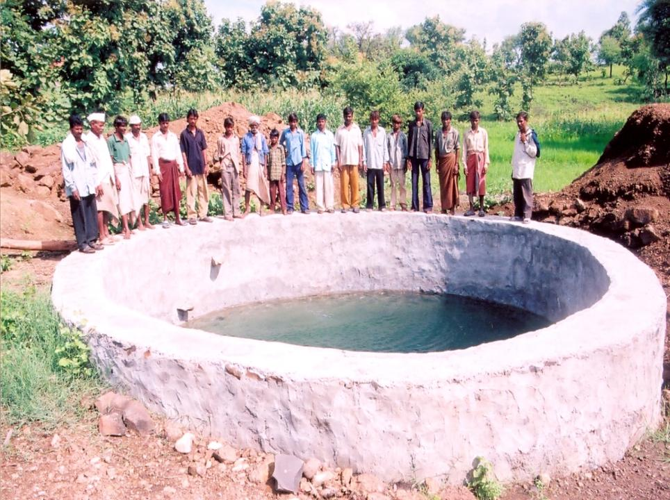
Well became perennial
Total 18,592 such wells developed or recharged

Slide 5
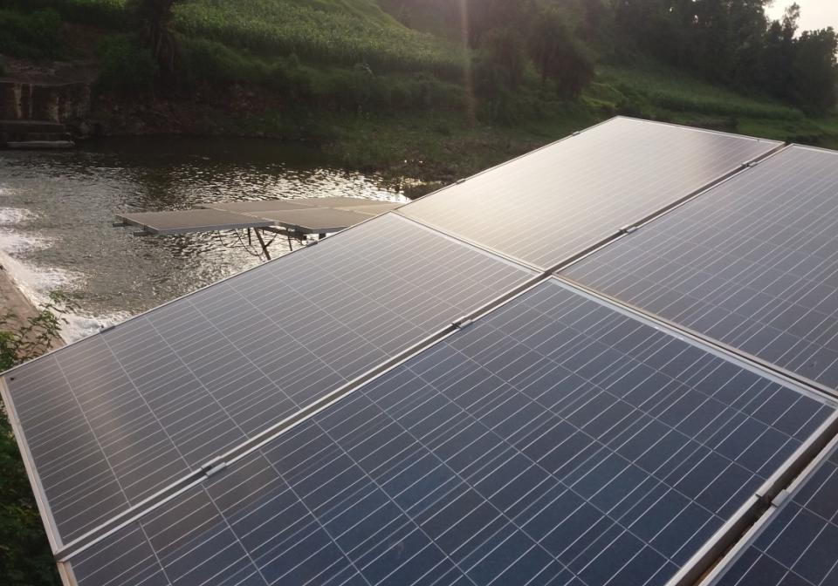
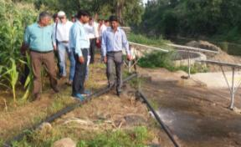
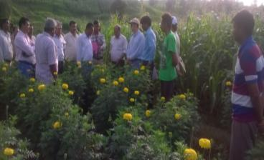
SOLAR BASED IRRIGATION AT VILLAGE KAMBOI, LIMKHEDA, DAHOD – IRRIGATING 4 ACRES OF FLORICULTURE

Slide 6
Climate change - Agriculture - Livelihood

Slide 7
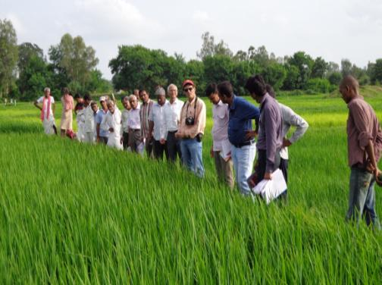
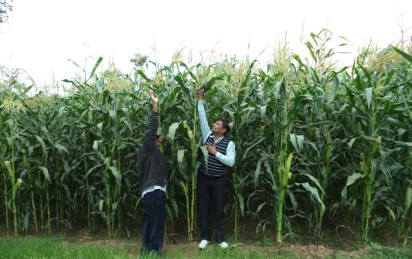
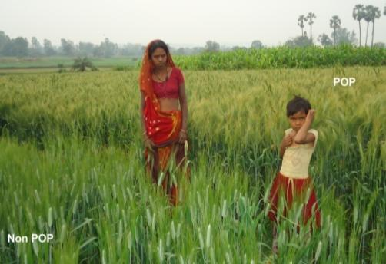
Agriculture Production Enhancement (through knowledge application and capacity building)
Rice in Kharif
Maize in Kharif
Wheat in Rabi

Slide 8
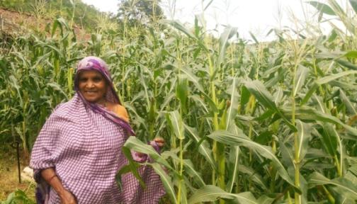
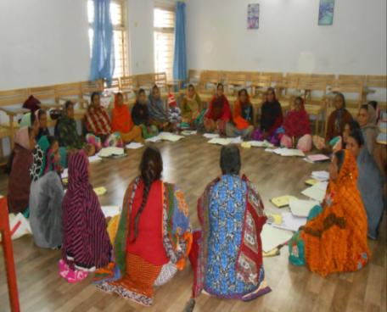
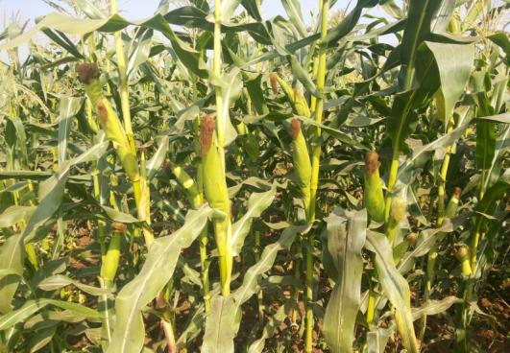
MAIZE SEED PRODUCTION

Slide 9
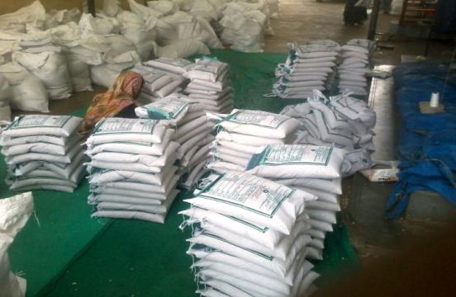
Grading and Packing being done for quality seed produced by Sadguru Farmers’ and CBOs
62,000 farmers provided with qality seeds produced by our farmers own institutions

Slide 10
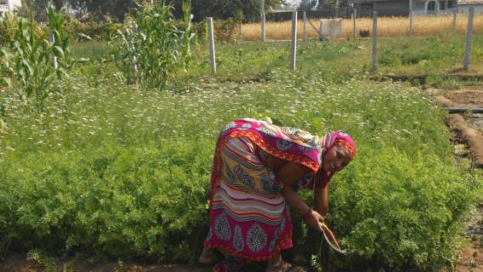
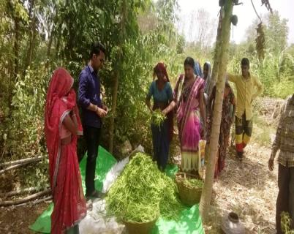
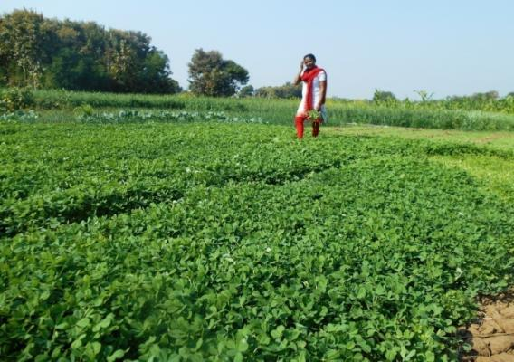
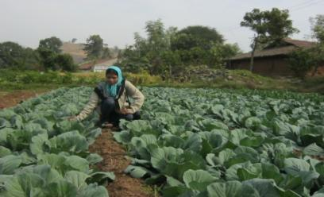
12000 FARMERS RAISED KITCHEN GARDEN FOR NUTRITION AT HOUSEHOLD LEVEL

Slide 11
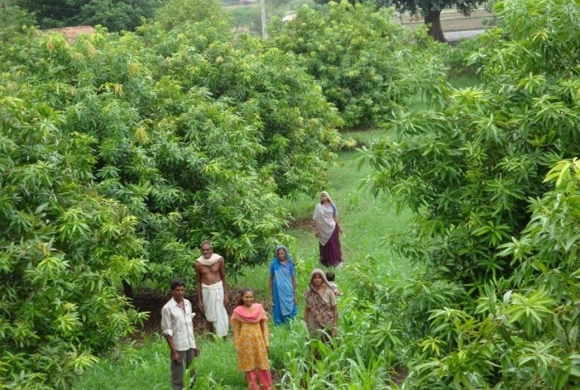
Diversification in Agriculture Climate friendly Horticulture
33,834 plots covering 33,834 farmers

Slide 12
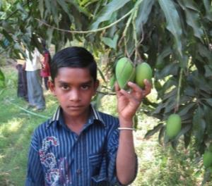
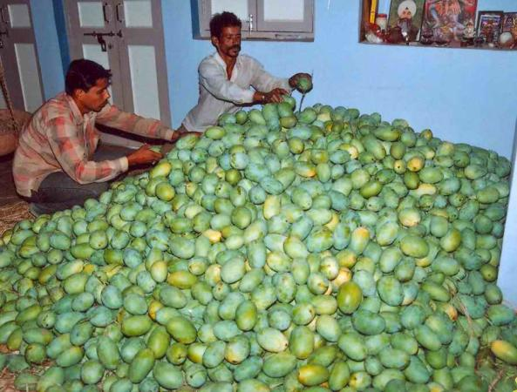
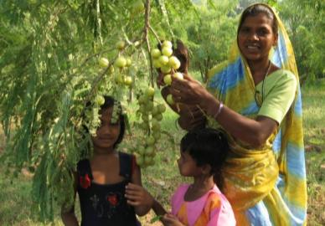
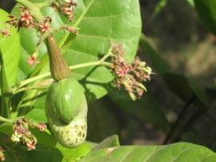
Horticulture : Fruit orchard

Slide 13
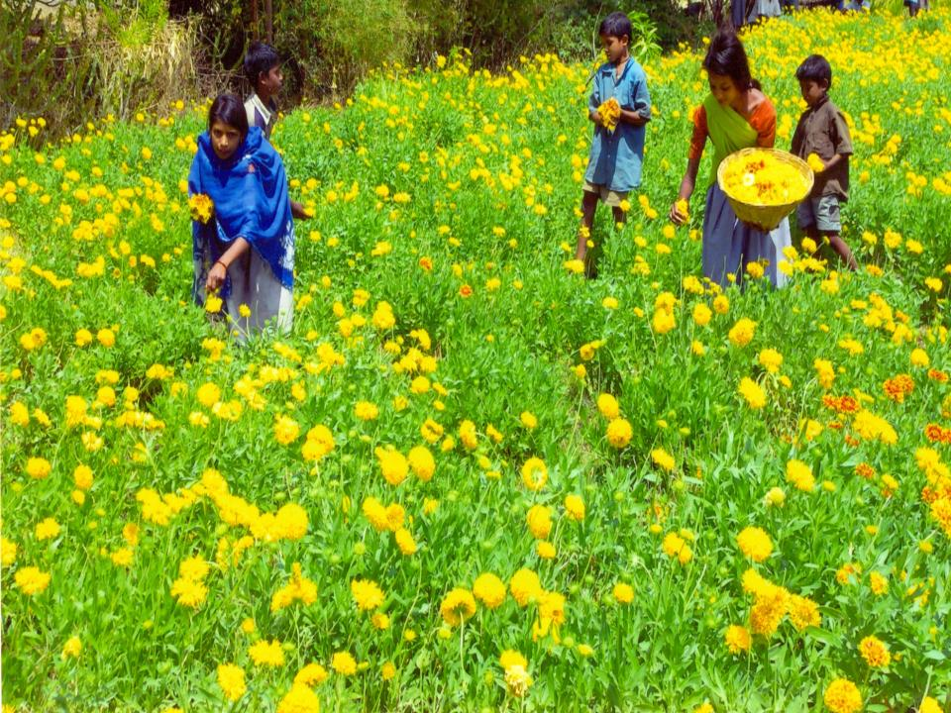
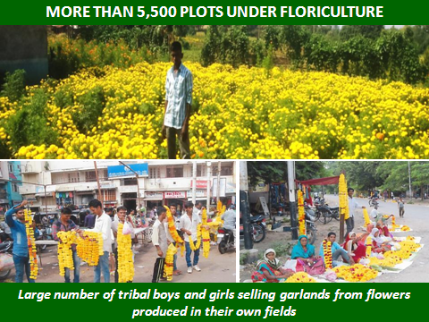
Floriculture on small piece of land means surety for about 10 fold income compared to traditional crop

