Slide 1
Earmarking the EU ETS-Revenues for climate action: a way forward for the EU ETS aviation dispute?
Dr Benito Müller
15 May 2012
Bonn Germany

Slide 3
“Sound Fiscal Management”?
Earmarking is said to be contrary to “sound fiscal management,”
there are situations in which the literature suggests that earmarking is appropriate.
Moreover, earmarking of revenue streams is actually common practice in most of the countries concerned (and beyond). The ‘trick’ has been to declare these revenues “off budget”.

Slide 4
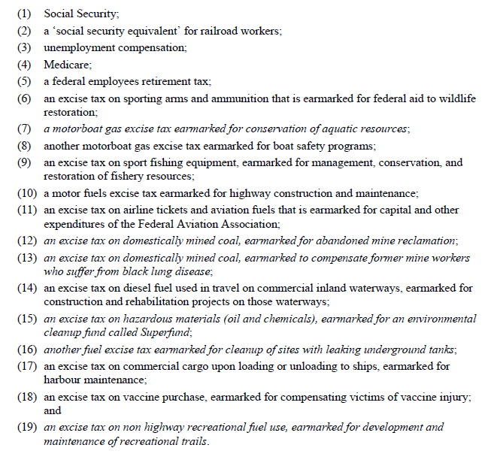
Earmarked Federal Taxes in the US

Slide 5
UK Renewables Obligation
The Renewables Obligation (RO), in effect since April 2002, is a legislated obligation on licensed electricity suppliers in England and Wales to buy a certain percentage of their supply each year from renewable sources. The obligation is monitored by the UK gas and electricity markets regulator Ofgem, based on the issuance of renewable obligation certificates.
Suppliers can choose to buy-out part of their obligation by paying Ofgem, which re-distributes the resulting revenue to suppliers in proportion to their renewable purchases as “recycled green premium.”
The Renewables Obligation provides £21.5bn (on a discounted basis) for the subsidy of renewable generation by UK electricity consumers. This is clearly a form of earmarking of a legally binding levy.

Slide 6
Off Budget Emissions Trading Trust Funds
The UK Renewables Obligation, could be a template for the purpose of raising revenue for (developing country) climate change activities from EU ETS auctioning.
All that needs to be done is to delegate the auctioning process at the national level to a body outside the taxation system − an “Office for Emissions Trading” – which operates an off budget trust fund, and which legitimately, and without fear of precedent for general taxation, channels earmarked revenue streams, say to the UNFCCC financial mechanism (for climate change activities in developing countries), to the private sector, and/or to treasuries, for the benefit of domestic consumers.

Slide 7
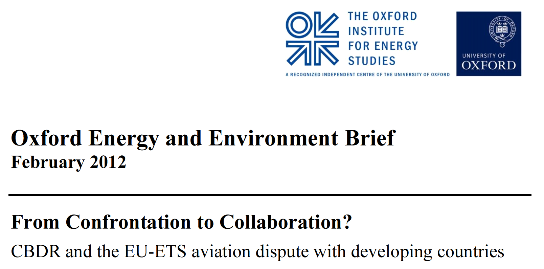
Operationalising Art. 3.1 CBDR/RC
[Art. 3.1] The Parties should protect the climate system for the benefit of present and future generations of humankind, on the basis of equity and in accordance with their common but differentiated responsibilities and respective capabilities. Accordingly, the developed country Parties should take the lead in combating climate change and the adverse effects thereof.

Slide 8
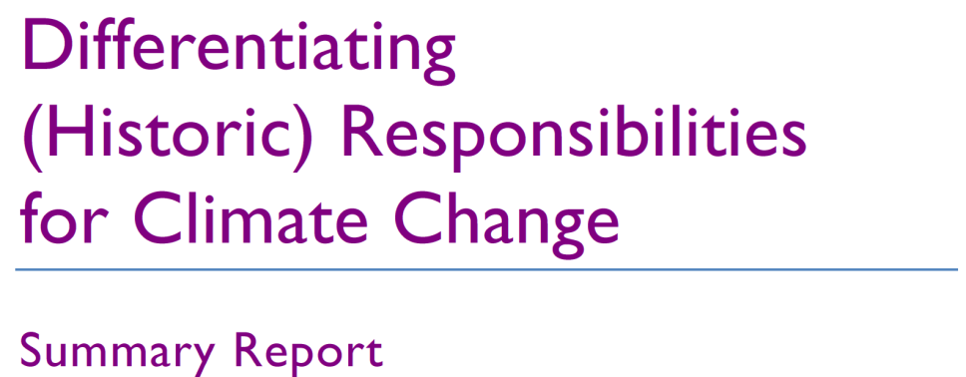
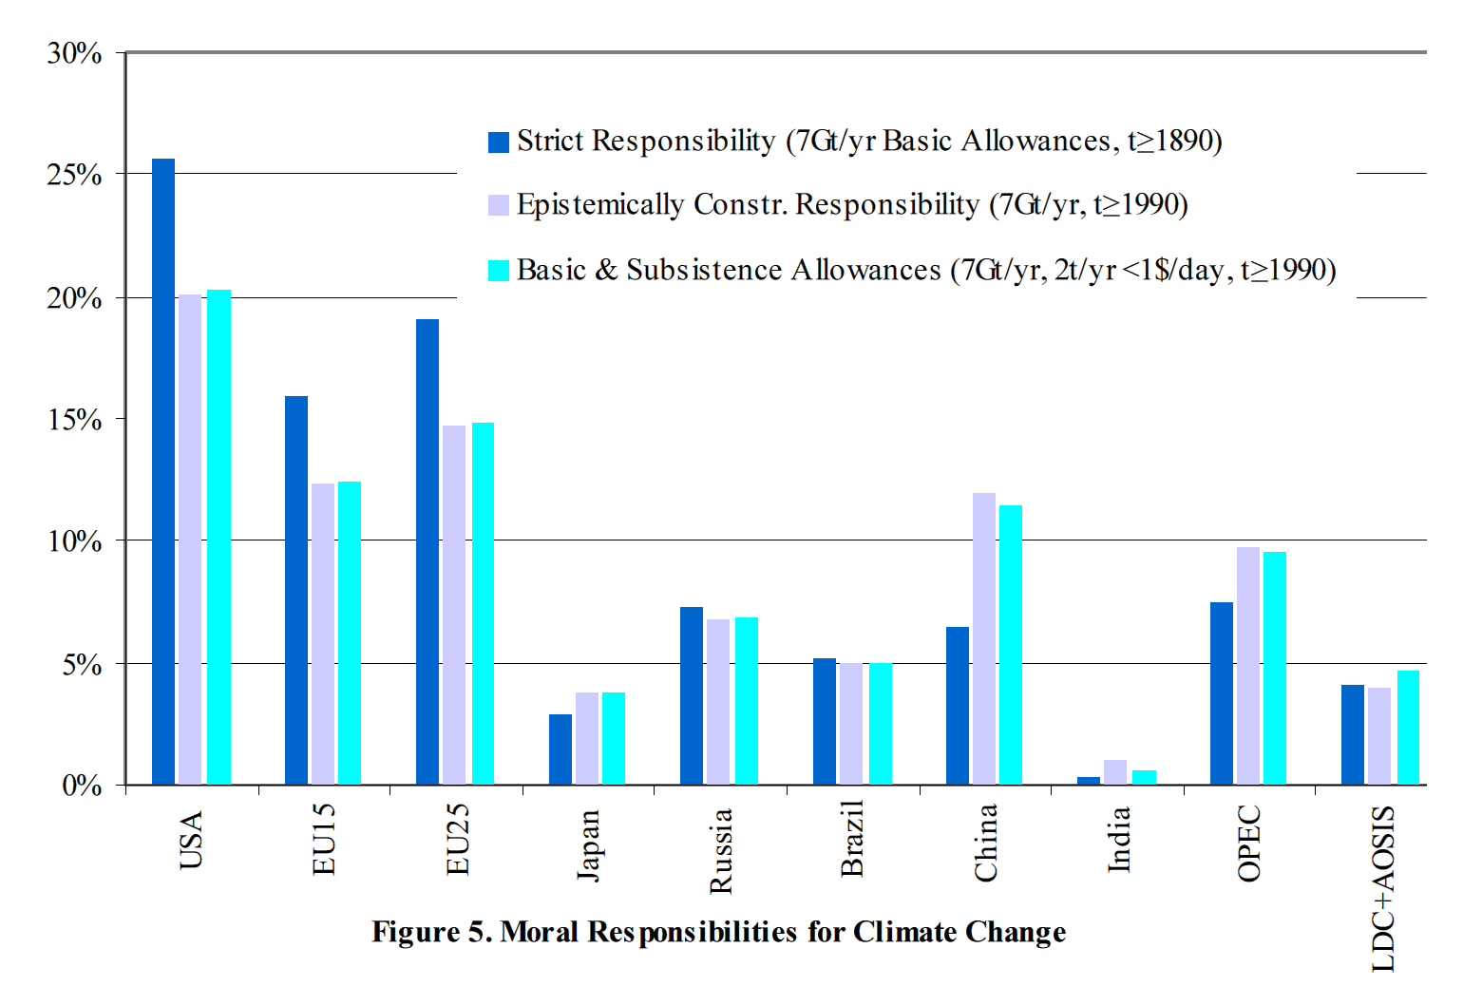
How?
‘This, then, is what the just is – the proportional; the unjust is what violates the proportion.’
Aristotle, Nicomachean Ethics, Book V
Benito Müller, Niklas Höhne,
and Christian Ellermann (October 2007)

Slide 9
What burden?
The burden of the effort, in this case represented by the level of emissions covered by the scheme

Slide 10
Compatibility Assessment
2 × global GDP/cap
0.5 × global GDP/cap

Slide 11
ETS Compromise Proposal
The Brief proposes the following measures to avoid such net South–North flows and to achieve compliance of the ETS with Art. 3.1 CBDR/RC as fully as practically possible:
All (developing) countries should be given the option to become ‘associate members’ of the ETS with respect to flights to and from their territory covered by the scheme. As such they would be entitled to co-decide the rules of the scheme and to carry out auctions of ETS aviation credits and keep the revenue for domestic climate change purposes.
Low-income developing countries not participating in this manner should receive the revenue collected at auction from their carriers by the developed ETS member countries.
Developing country carriers should be able to use Certified Emission Reductions (CERs) generated in their country of origin through the Clean Development Mechanism (CDM) for the purpose of compliance with the ETS for the full duration of the scheme.

