Slide 1
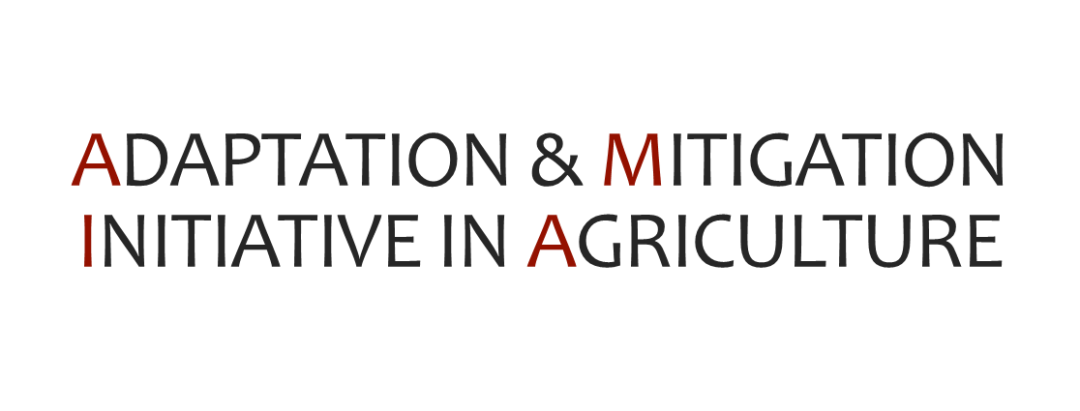
Notes:
Overall vision: The Philippine agri-fisheries sector would enable local communities to manage climate risks (RESILIENT)
while pursuing sustainable livelihoods (YET PROGRESSIVE)

Slide 2
Resilient yet progressive ▹ Agriculture and Fisheries ▹ Livelihoods and Communities
AMIA 1
(April 2015- September 2016 )
Establishing the enabling environment
Guidelines for planning based on landscape approach using AMIA maps
Recommendations for adjusting policy instruments and development programs/projects
Capacitating DA AMIA teams to mainstream CC issues in DA plans, programs, and budgets

Slide 3
Building Climate-Resilient ▹ Agriculture and Fisheries ▹ Livelihoods and Communities
AMIA 2
(April 2016-January 2017)
AMIA 2+
(November 2016-2017/18)
Planning & Targeting for Climate-Resilient Agriculture
Assessment, planning & piloting for climate-resilient communities and livelihoods
Establishing & Outscaling Climate-Resilient Agriculture
Establishing and outscaling community-level research and development actions for climate-resilient agriculture

Slide 4
AMIA Framework for Building Climate-Resilient Livelihoods & Communities
ESTABLISHING ENABLING ENVIRONMENT
KNOWLEDGE MANAGEMENT FOR RESULTS
mainstreamed policies/practices, strengthened capacities, identified emerging opportunities
VULNERABILITY ASSESSMENT AND RISK TARGETING
key risks identified with exposure and adaptive capacity assessed
DEVELOPING KNOWELDGE POOL OF CLIMATE-RESILIENT AGRICULTURE (CRA) OPTIONS
CRA COMMUNITY ACTION-LEARNING: INITIAL PHASE
ENHANCING SERVICES AND INSTITUTIONS
field-validated models and innovations
INTEGRATING CRAs WITHIN AGRI-FOOD SYSTEMS AND VALUE CHAINS
use-oriented monitoring and evaluation and evidence-based decision support
comprehensive resource pool of CRA innovations
resilience-driven livelihoods
improved access and local relevance
CRA ACTIONS AND OUTCOMES AT SCALE
implementation within and across regions/systems
PROGRAM MANAGEMENT AND PARTNERSHIP PLATFORMS
high-performing teams and alliances

Slide 5
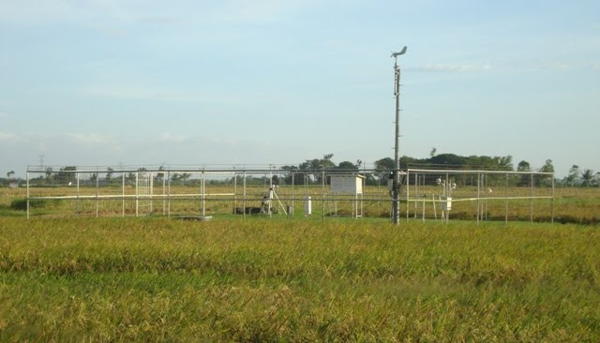
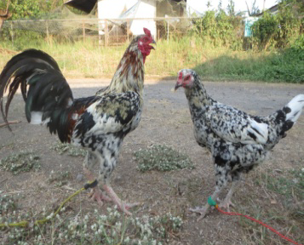
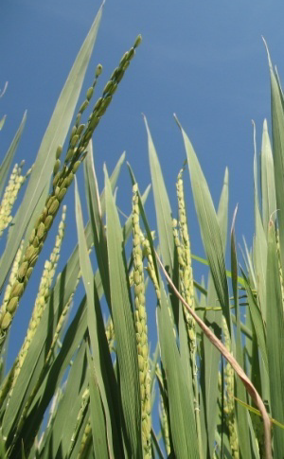
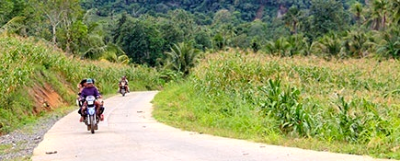
Integrated Support Services
Climate Advisory
CCA Credit
Agri-Aqua Insurance
Productivity-enhancing technologies
CCA measures
Market linkage
Other support services
Mechanism to integrate agricultural support services to assist communities in the implementation of climate change adaptation measures

Slide 6
Evidence for National Adaptation Plan for Agriculture & Fisheries
ESTABLISHING ENABLING ENVIRONMENT
KNOWLEDGE MANAGEMENT FOR RESULTS
mainstreamed policies/practices, strengthened capacities, identified emerging opportunities
Disaster/CC risks
VULNERABILITY ASSESSMENT AND RISK TARGETING
key risks identified with exposure and adaptive capacity assessed
Learn from previous/ongoing work /
low-hanging fruit
DEVELOPING KNOWELDGE POOL OF CLIMATE-RESILIENT AGRICULTURE (CRA) OPTIONS
CRA COMMUNITY ACTION-LEARNING: INITIAL PHASE
ENHANCING SERVICES AND INSTITUTIONS
Agriculture and Fisheries Modernization Plan 2017-2023
field-validated models and innovations
INTEGRATING CRAs WITHIN AGRI-FOOD SYSTEMS AND VALUE CHAINS
use-oriented monitoring and evaluation and evidence-based decision support
Philippine Development Plan 2016-2022
comprehensive resource pool of CRA innovations
resilience-driven livelihoods
improved access and local relevance
CRA ACTIONS AND OUTCOMES AT SCALE
implementation within and across regions/systems
Weather/climate information services to enhance understanding of risk & uncertainty
PROGRAM MANAGEMENT AND PARTNERSHIP PLATFORMS
high-performing teams and alliances
Stronger M&E for DRR & CCA

Slide 7
AMIA will allow us to migrate from
national commodity-based planning to
to achieve food security and inclusive growth for
poverty reduction.
Science- and risk-based
Agro-ecology sensitive
Location-specific planning

Slide 8
DA Systems-Wide Climate Change Office (DASWCCO)
amiaphilippines@gmail.com

