Slide 1
The pathway to low carbon economic growth
2016
The Ministry of Economic Development of the Russian Federation
Yaroslav Mandron
Director of Department for Tariffs Regulation, Infrastructural Reforms and Energy Efficiency

Slide 2
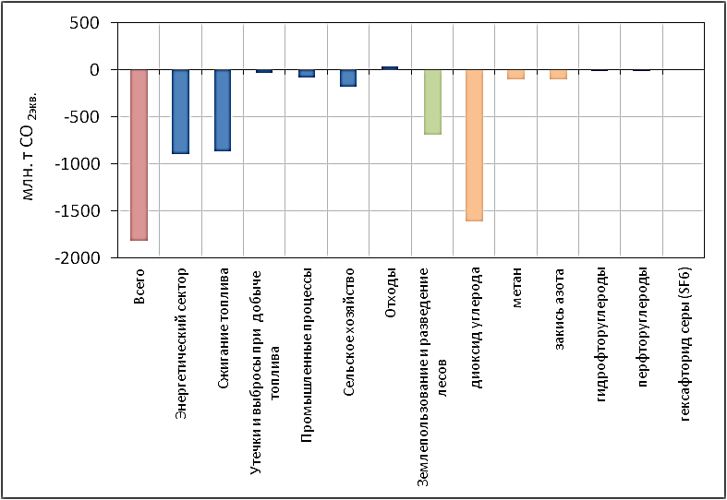
Anthropogenic GHG emission drop in Russia from 1990 to 2015 , by sources and gases (million tons CO2-eqv)
In 2015 GHG emission from energy sector were 29% below as compared with those of 1990’s level, while emission from fossil fuel combustion decreased by 39%, from industrial processes – by 28% , from agriculture – by 60% for the same period.
GHG emission level of 1990
Mln t CO2-eqv
Total
Power generation
Fuel combustion
Exploration
Industrial process
Agriculture
Wastes
Forestry
CO2
CH4
N2O
HFC
PFC
SF6
The Ministry of Economic Development of the Russian Federation

Slide 3
Dynamics of GHG emission and GDP in Russia for the period from 1990 to 2014
GDP, bln roubles measured in 2008 prices
42500
22200
Since 1998 Russia has demonstrated ability to economic development with minimum GHG emission’s increment
1600
1685
GHG emission with LULUCF, mln tons CO2-eqv
1998 1999 2000 2001 2002 2003 2004 2005 2006 2007 2008 2009 2010 2011 2012 2013 2014 2015
The Ministry of Economic Development of the Russian Federation

Slide 4
Low emission technologies share in power generation in Russia is much higher as compared with those in selected key GHG emitters
Low-emission technologies ratio
Structure of power generation in Russia and selected countries in 2015
70
65
57
25
16
0,3
15,7
20
21*
13*
4
18
2
5
26
30
9
48
75
84
35
43
18
Russia USA Germany India China
Renewables
Hydro
Nuclear
Gas
Coal
* For India and China index shown as sum of Nuclear + Hydro + Renewables
The Ministry of Economic Development of the Russian Federation

Slide 5
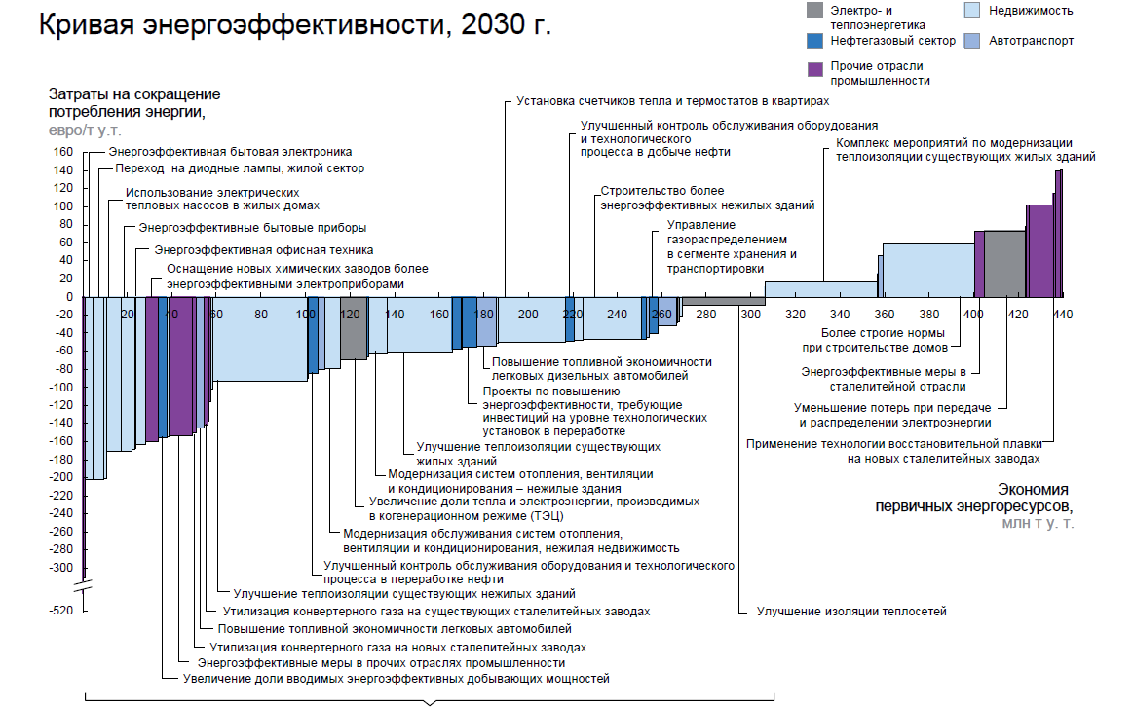
298 bln. euros saving for the period from 2015 to 2035 requires investment in sum of 117 bln. euros
Power and heat production
Oil and gas sector Other industries
Real estate
Transport
Energy efficiency curve, by 2030
Expenses for energy consumption reduction, euro/toe
Heat meter and thermostat installations in apartments
Energy efficient consumer electronics
LED lamps in residential sector
Heat pumps in residential buildings
Energy efficient home appliances
Energy efficient office equipment
Energy efficient instrumentation
for new chemical plants
Improvement of control in oil extraction and processing
Package plan for residential buildings insulation
Construction of energy efficient non-residential buildings
Gas distribution and transportation management
New construction standards
Fuel efficiency improvements for diesel auto
New technologies in steel industry
Анастасия Алексеевна <grishenok@expo-elektra.ru>
Measure related to technological modernization investments
Loss enhancement in power production and transmission
Insulation of current residential buildings
MIDREX process introduction in steel industry
Heating, ventilation, air-conditioning improvement in non-residential buildings
CHP share gains
Primary energy resources saving, mln. toe
Heating, ventilation, air-conditioning improvements improvement in real estate
Oil processing control system improvements
Insulation of present non-residential buildings
Converter gas utilization for present steel capacities
Insulation of district heating networks
Fuel efficiency improvement for gasoline-powered auto
Converter gas utilization for new steel installations
Energy efficient measures in other industrial sectors
Share gains of energy efficient extractive capacity commissioning
Profitable investments
Annual investments for profitable measures are accounted as 6 bln euros during next 20 years
For instance – total expected investments in Russian economy (for the period of 2015-2035) are accounted as 200-300 bln euros
So energy efficiency measures promotion requires about 2-3% of total investments in economy
The Ministry of Economic Development of the Russian Federation

Slide 6
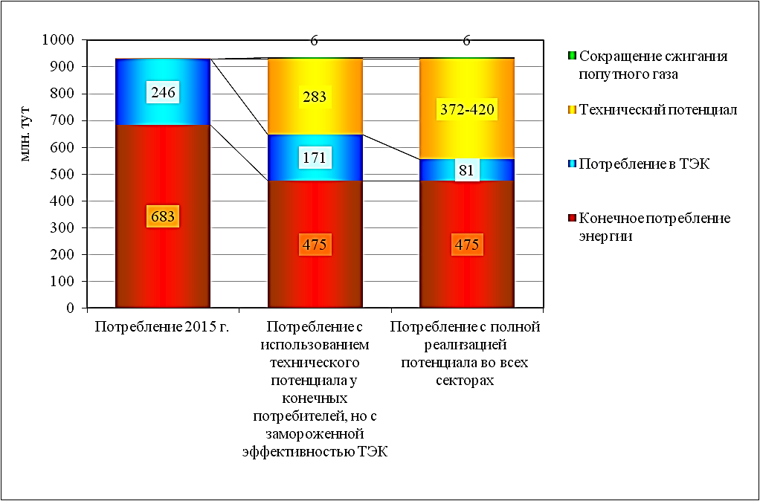
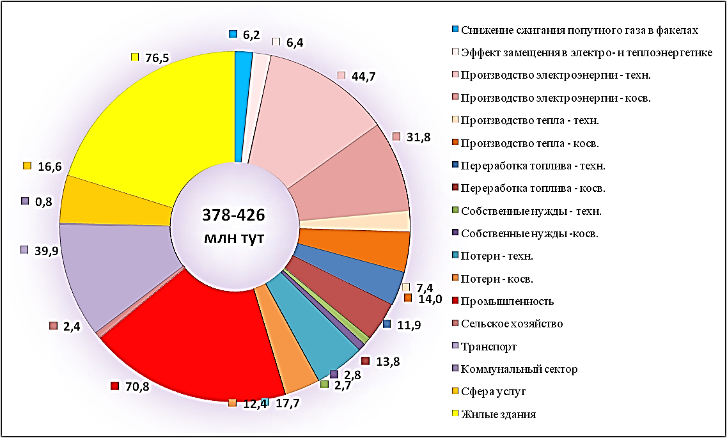
Energy efficiency potential in Russia in 2015 (mln toe)
Integral estimate of technical potential of energy saving in Russia in 2015 (mln toe)
Associated gas flaring decrease
Substitution effect in heat and power sector
Electricity production – direct
Electricity production – indirect
Heat production - direct
Heat production – indirect
Fuel processing – direct
Fuel processing – indirect
Auxiliaries - direct
Auxiliaries – indirect
Losses – direct
Losses - indirect
Reduction of associated gas flaring
Technical potential
Consumption in power industry
Final energy consumption
Mln toe
378-426
mln toe
Consumption
2015
Consumption with use of technical potential of the final consumers but without power sector improvements
Consumption with implementation of energy efficient measures in all sectors
Industry
Agriculture
Transportation
Communal sector
Services
Residential buildings
Expected GHG emission growth was balanced by following factors: structural changes in economy contributed toward 68% of GHG emission reduction; reduction of carbon emission intensity in power sector ensured also provided 4% due to increase of natural gas use, nuclear and hydro power production; energy efficiency measures provided 9%; capacity utilization growth contributed 2%; and price factor encouraged 1% as well.
Since main GHG sources comes from such sectors like power generation, housing and public services, transportation which are slightly exposed by business cycle fluctuations it used to slow GHG emission reduction when GDP decrease and otherwise stunt GHG emission growth when GDP increase.
The Ministry of Economic Development of the Russian Federation

Slide 7
Action plan to ensure economic growth with low GHG emission
Phase I Arrangements
Phase II Economical incentive and promotion of measures for
energy efficiency increase
Phase III Introduction of GHG regulation system
СО2
2016
2017
2018
Renovation of infrastructure in heat and power production sector
2030
Activity plan for fulfillment of obligations to reduce GHG emission by the year 2020 as 75% of 1990’s level.
«Reload» of national policy in energy efficiency area
Development of the state-run program for energy efficiency growth and strategy of low carbon economy
Formation of data bank of model energy efficient projects
Development of co-generation for wide power range;
Creation of benchmarking system for energy efficiency thresholds
Foreign capital attraction
Establishment of minimum requirements for energy efficiency of the buildings
Development of GHG regulation model.
The Ministry of Economic Development of the Russian Federation

Slide 8
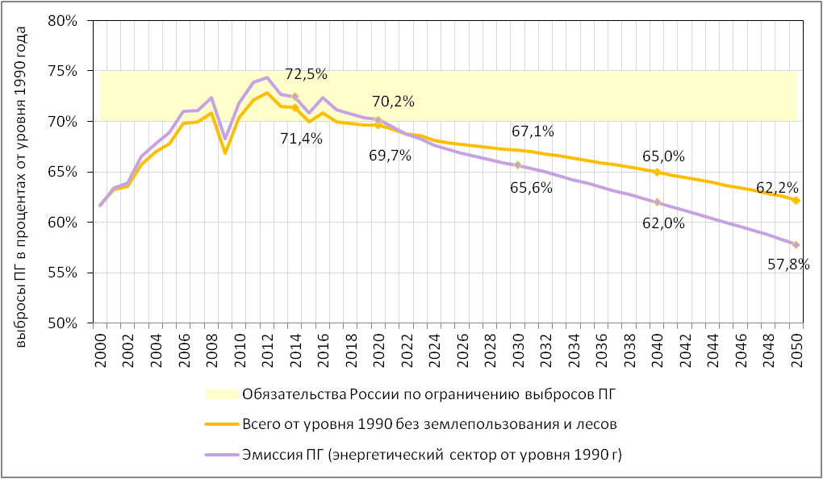
Projection of anthropogenic GHG emission in all sectors as compared with 1990 level for energy efficient scenario
GHG emission as percentage of 1990 ‘s emission level
Russia’s obligations for GHG emission limit
Total w/o LULUCF
GHG emission from energy sector
The Ministry of Economic Development of the Russian Federation

