Slide 1
The West Africa Regional Hub of the Independent Global Stocktake (iGST)
Kwame Hackman (PhD), Ramata Ouedraogo (MSc)
01 December 2023
https://igstwahub.org

Slide 2
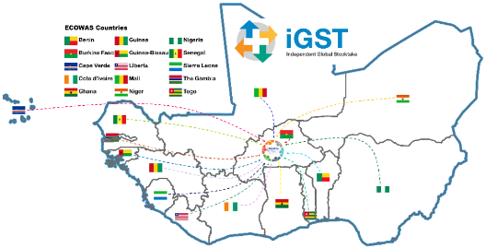
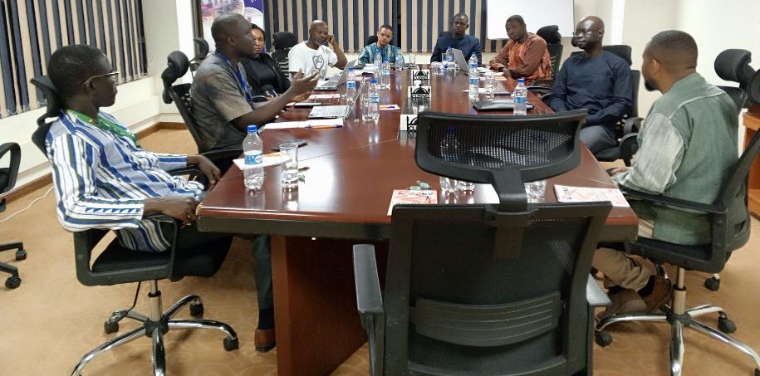
https://igstwahub.org

Slide 3
Objective
To bring together interested civil society organisations (CSOs) in West Africa (with a focus on the ECOWAS region) to contribute to the implementation of the Paris with a focus on the GST.
The entire process was bottom-up based on principles equity and inclusivity.
https://igstwahub.org

Slide 4
Steps
Stakeholder mapping
Regional assessment
Country-level meetings
Validation + launch (regional)
https://igstwahub.org

Slide 5
GST-Related Activities
Awareness creation around the GST-related concepts in West Africa
Submission of inputs for consideration by the GST 1 co-facilitators.
Technical discussions of the GST inputs (TD1.1-1.3).
https://igstwahub.org

Slide 6
Challenges
The bottom-up approach is a slow, time-consuming process.
Management of 3 official languages (French, English, Portuguese). This challenge is more pronounced now as we operationalize the hub (e.g., core working group engagements).
Sustainability of the interest of members organizations. [Here, the endorsement of Parties in the region (for example) is key]
https://igstwahub.org

Slide 7
Strategies (Post-GST1)
Assessment
(NDC + implementation)
Support for small projects
Capacity building (GST-related topics and timelines)
Endorsement of Parties
https://igstwahub.org

Slide 8
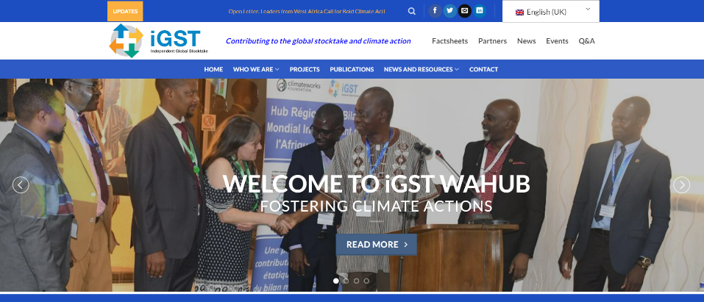
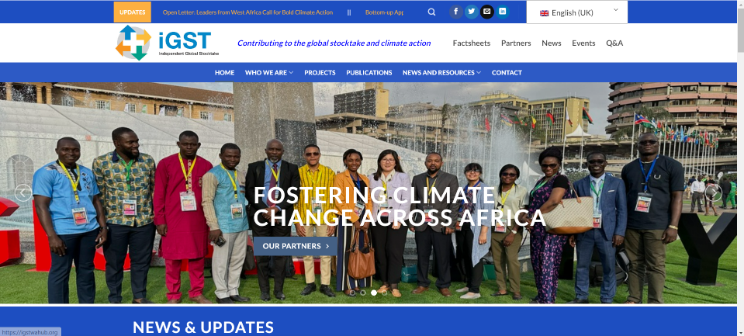
Visit our website https://igstwahub.org for more information
https://igstwahub.org

Slide 9
Short video
https://igstwahub.org

Slide 10
Thank you!

