Slide 1
Jörn Brömmelhörster
East Asia Department, Asian Development Bank
6 December 2011, Durban, South Africa

Slide 2
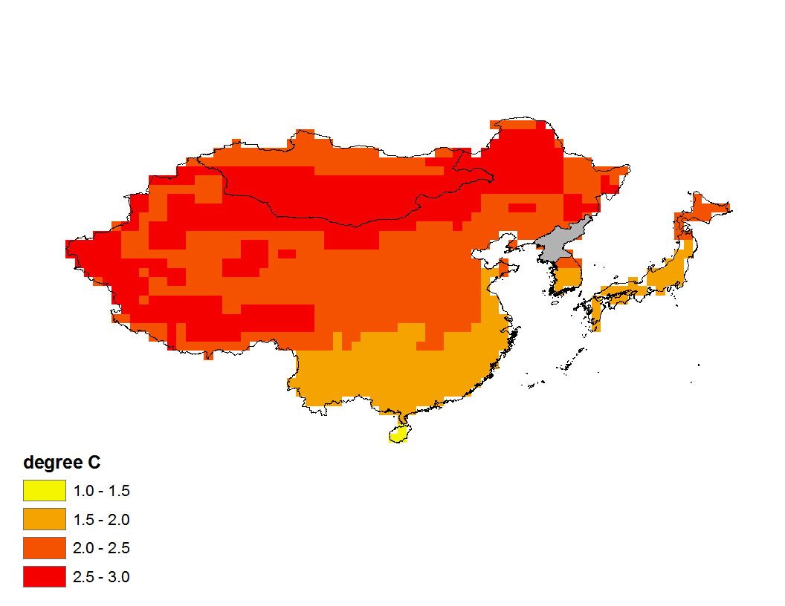
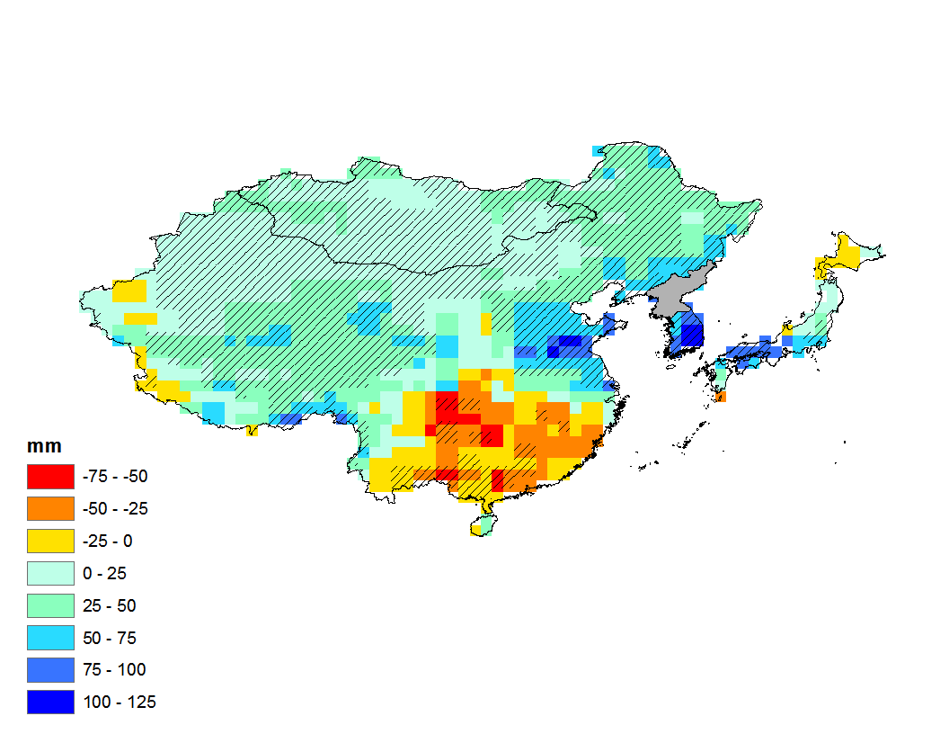
Change in Mean Annual Temperature (2050s)
Change in Mean Annual Precipitation (2050s)
(Median of 17 GCMs; 2045 – 2056 vs. 1961 – 1990; A2 emissions scenario)
(Median of 17 GCMs; 2045 – 2056 vs. 1961 – 1990; A2 emissions scenario)

Slide 3
The First Regional Climate Change Study for Northeast Asia
Objectives
(i) Help prioritize adaptation and mitigation in the region
(ii) Better understanding of financing needs for adaptation and mitigation in the region
(iii) Identify possible areas of regional cooperation, e.g. mitigation and carbon trading, technology transfer, adaptation practices

Slide 4
Components
(i) Calculation of the costs of adaptation until 2050
Infrastructure and water resources, coastal protection, and agriculture
(ii) Analyze the cost of mitigation options and generation of marginal abatement cost (MAC) curves for the years 2020 and 2030
(iii) Calculation of economy-wide climate change impacts and estimation of financing needs through the year 2100 using Integrated Assessment Models

Slide 5
Framework
Macroeconomic, demographic, and standard emissions scenarios
Adaptation
Impact and costs on water, physical infrastructure, agriculture, and coastal areas
Mitigation
Energy and emissions
MAC curves
Integrated Assessment Models
Country reports and databases

Slide 6
Participating Institutions
Japan
National Institute for Environmental Studies (NIES)
Institute for Global Environmental Strategies (IGES)
Mizuho Information and Research Institute
Republic of Korea
Global Green Growth Institute
Seoul National University
People’s Republic of China
National Development and Reform Commission (NDRC)
Tsinghua University
Mongolia
Clean Development Mechanism Center
Institute of Meteorology and Hydrology
University of Science and Technology of Mongolia
Other Participating Institutions
Massachusetts Institute of Technology, USA
University of Colorado at Boulder, USA
University of Edinburgh, UK
University of Southampton, UK
International Institute for Applied Systems Analysis, Austria
Basque Centre for Climate Change, Spain

Slide 7
Preliminary Results
1. Costs of Adaptation in Infrastructure
Northeast Asia has large ‘adaptation deficit’ to current climate variability, e.g. floods and cyclones. It makes economic sense to address this now.
Priority adaptation investments include
- Water infrastructure due to increased variation of rainfall
- Coastal infrastructure due to sea level rise and storm surges
→ It shall be noted that ‘climate proofing’ of physical infrastructure is not a simple task. It all depends on the infrastructure type, the level of risk aversion and assumed social discount rate.

Slide 8
Preliminary Results
2. Mitigation and MACCs
Large mitigation potential in NE Asia – approx. 7 Gt CO₂ in 2030 (using a carbon cut-off price of $100/tCO₂).
Large amount of abatement potential at negative cost (‘win-win’) – ($100/tCO₂).
Mitigation in NE Asia has significant co-benefits, e.g., enhanced energy security in PRC – oil consumption declines in 2030 from 18% to 10% and coal 57% to 43% of primary energy consumption, respectively, compared to Business-As-Usual
A delay reduces future mitigation potential in NE Asia – e.g., for PRC, a delay of only 5 years in the power sector results in a reduction in mitigation potential of 15% in 2020 and 10% in 2030 due to lock-in effects

Slide 9
Preliminary Results
3. Integrated Assessment Modeling
The cost of climate change will be significant for NE Asia in the coming decades
No winners – Mongolia likely the most vulnerable
If the World implements the mitigation pledges from Copenhagen and Cancun COPs, there will be net positive economic benefits for NE Asia (i.e., Costs < avoided damages)
Regional cooperation would save costs and foster benefits

Slide 10
Thank you!
谢谢
ありがとうございます
감사합니다.
Баярлалаа
For further questions, pls contact:
Jörn Brömmelhörster (jbrommelhorster@adb.org)

