Slide 1
Empowering youth engagement in climate action, solutions, and policy TO address global challenges
Sunday, December 10, 2023 at 16:45—18:15 Expo 2020 Blue Zone – SE Room 2 (173 pax)

Slide 2
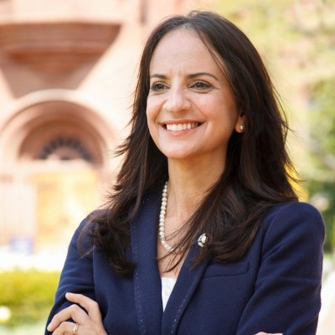
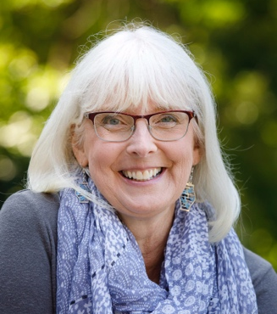
Educators/mentors
GUEST SPEAKER:
Dr. Carol O’Donnell
Smithsonian Science Education Center
Smithsonian Institution
Email: ODonnellC@si.edu
MODERATOR
Dr. Diane Husic
Dean, Center for Scholarship, Research, and Creative Endeavors
Environmental Programs Director
Moravian University
Email: husicd@moravian.edu
YEAH core faculty:
Dr. Gillian Bowser, Colorado State University
Dr. Sarah Green, Michigan Technological University
Dr. Leah Dundon, Vanderbilt University
Dr. Pamela Templer, Boston University
Dr. Sarah Hautzinger, Colorado College
Dr. Susie Ho, Monash University
Dr. Mark Urban, University of Connecticut
Dr. Susie Ho, Monash University
Dr. Diane Husic, Moravian University
Climate Leaders Academy co-leads:
Dr. Leah Dundon, Vanderbilt University (PI)
Dr. Sarah Green, Michigan Technological University
Dr. Pamela Templer, Boston University
Dr. Jianwei Li, Tennessee State University

Slide 3
Key questions:
Amidst the ever-changing and increasingly complex challenges facing the planet and humanity, what is needed to educate the next generation of environmental stewards and leaders who are global citizens with sustainability mindsets?
How can we create social entrepreneurs who will innovate and put information to action to help address complex challenges like climate change and sustainable development?

Slide 4
https://yeah-net.org
YEAH is supported by the National Science Foundation under Award numbers 2019049, 2130739, and 2130725. https://www.nsf.gov.

Slide 5
https://www.unsdsn.org/australia-nz-pacific
https://www.unsdsn.org/united-states
https://ssec.si.edu

Slide 6
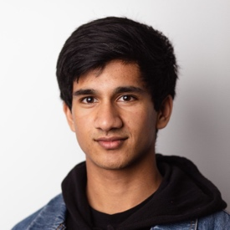
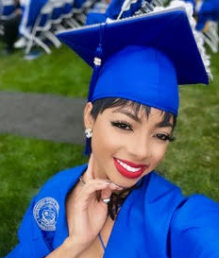
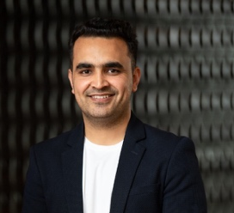
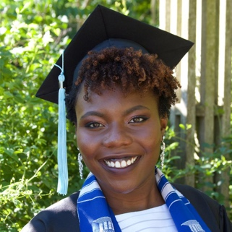
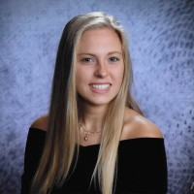
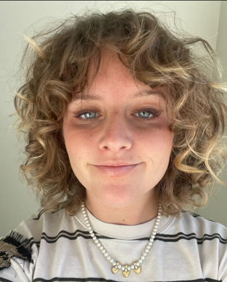
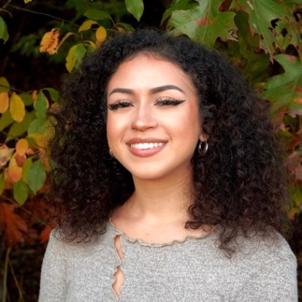
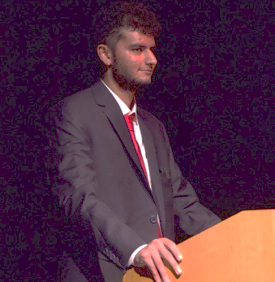
Our student and early career panelists
Kaaviyan Pathmasiri
Monash University
Nadeem Hamidullah
Monash University
Najma C. Thomas
Vanderbilt University
DaKennya Goines
Tennessee State University
Allison Ludlow
Moravian University
Sasha Gilmore
Boston University
Zoraiz Zafar
Colorado College
Lucy Kramer
Colorado College

Slide 7
Educators/mentors
GUEST SPEAKER:
Dr. Carol O’Donnell
Smithsonian Science Education Center
Smithsonian Institution
Email: ODonnellC@si.edu
MODERATOR
Dr. Diane Husic
Dean, Center for Scholarship, Research, and Creative Endeavors
Environmental Programs Director
Moravian University
Email: husicd@moravian.edu
YEAH core faculty:
Dr. Gillian Bowser, Colorado State University
Dr. Sarah Green, Michigan Technological University
Dr. Leah Dundon, Vanderbilt University
Dr. Pamela Templer, Boston University
Dr. Sarah Hautzinger, Colorado College
Dr. Susie Ho, Monash University
Dr. Mark Urban, University of Connecticut
Dr. Susie Ho, Monash University
Dr. Diane Husic, Moravian University
Climate Leaders Academy co-leads:
Dr. Leah Dundon, Vanderbilt University (PI)
Dr. Sarah Green, Michigan Technological University
Dr. Pamela Templer, Boston University
Dr. Jianwei Li, Tennessee State University

