Slide 1
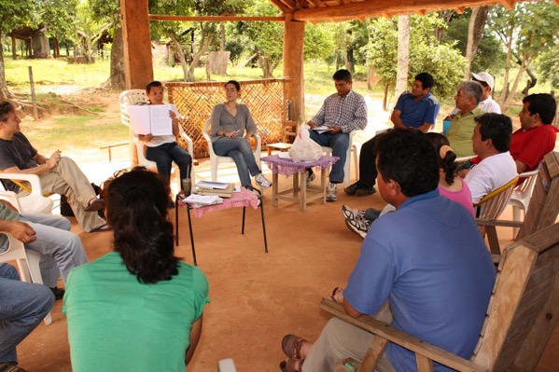
Time to Choose: Corporations or Communities?

Slide 2
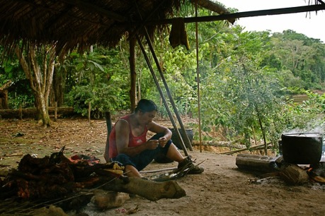
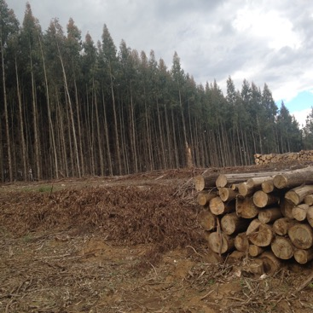
Where does climate finance for forest and other land use projects go, and why?
Notes:
Projects like IIN and the women’s groups, and Chaski Warmi, are holistic, contribute to llivelihoods, resilience and mitigation.

Slide 3
Forest Investment Program (FIP)
Aims to provide direct investments to developing countries to support their development and REDD+ objectives
23 FIP countries:
14 of them already approved as pilot countries
9 elaborating their Investment Plans (IPs)
Dedicated Grant Mechanism for Indigenous Peoples and Local Communities (DGM) and Private Sector Set-Aside Program (PSSA)
By December 2015, USD 775.2 million pledged from which USD 555.3 are endorsed and only 36.1 million was disbursed by the beginning of 2016
It mainly provides loans instead of grants, and/or blended finance (public funds to attract private investments) which means projects have to be commercially profitable. Monoculture tree plantations are more profitable than conservation and restoration initiatives by women, Indigenous Peoples and smallholders

Slide 4
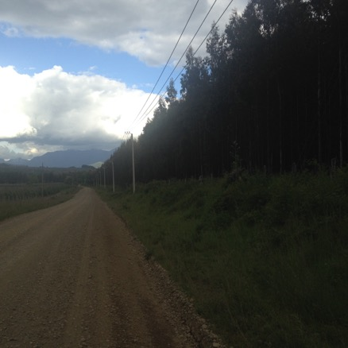
FIP and Monoculture Tree Plantations
Tree plantations are aknowledges as a key driver of deforestation in many national FIP Investment Plans
But the definition of “forests” leaves space for plantations
However, most Investment Plans also include plantations as “a means to reduce pressure on forests”
For instance:
Ghana: states the need for further research…”on crops and trees..biofuels such as oil palm and jatropha, and trees such as rubber...to reduce the carbon footprints …”
Indonesia: assistance to meet the increasing wood volumes for local and export demand . The private sector goal in FIP is to support the business of sustainable forestry, both natural and plantation, to be more efficient

Slide 5
UN-REDD and Forest Carbon Partnership Facility (FCPC)
Support nationally-led REDD+ readiness processes including those that support tree plantations:
Jari Amapá REDD project, Brazil: 65,980 ha. Project run by logging and pulp companies
Kikonda carbon tree plantation project, Uganda: 8000 ha of pine plantations.
Burkina Faso: different types of plantations, including commercial reforestation plantations, interesting private companies or communities is a measure to achieve REDD+ goals
Indonesia: “Establishment of additional fast growing pulp and timber plantations on non- forest and non -peat lands can create an alternative source of timber and reduce pressure on rain forests and will allow for a doubling in size of pulp and oil palm production and to a major increase in export revenues”.

Slide 6
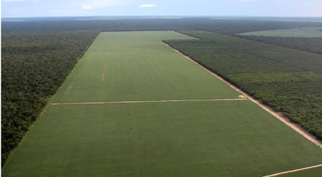
Global Environment Facility
Established in 1991, original financial mechanism of UNFCCC
Supports forest conservation under its climate, biodiversity and forest themes
UNDP Small Grants Program: Provides public support to conservation initiatives by Indigenous Peoples, local communities and women, but amount of funding has stabilized
Market-based and private sector-driven approaches: Pilot programs on on-grants instruments and integrated approaches. Working with large corporations to create markets for coffee, “deforestation-free” soy: no limits to growth agenda, which triggers land grabbing and herbicide contamination amongst communities

Slide 7
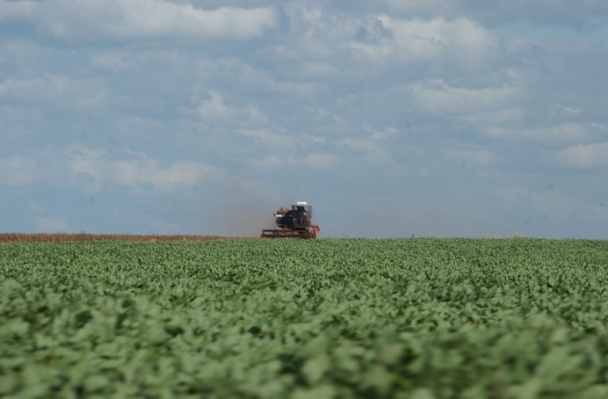
Public Private Partnerships like the Global Alliance on Climate Smart Agriculture: Conflicts of interests and no limits to growth

Slide 8
Thank you!

