Slide 1
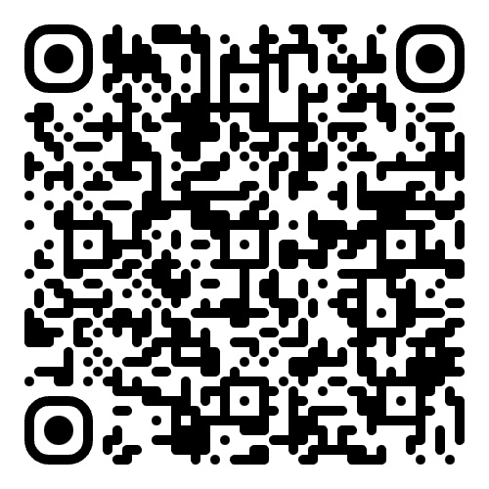
No climate justice without civic space and meaningful participation
Sign Amnesty International's petition

Slide 2
Sign the petition: Release Journalists and Activists

