Slide 2
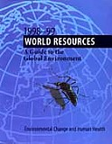
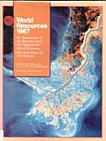
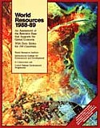
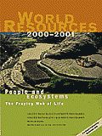
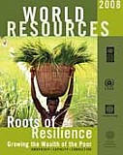
History of the World Resources Report

Slide 3
WRR – A New Model

Slide 4
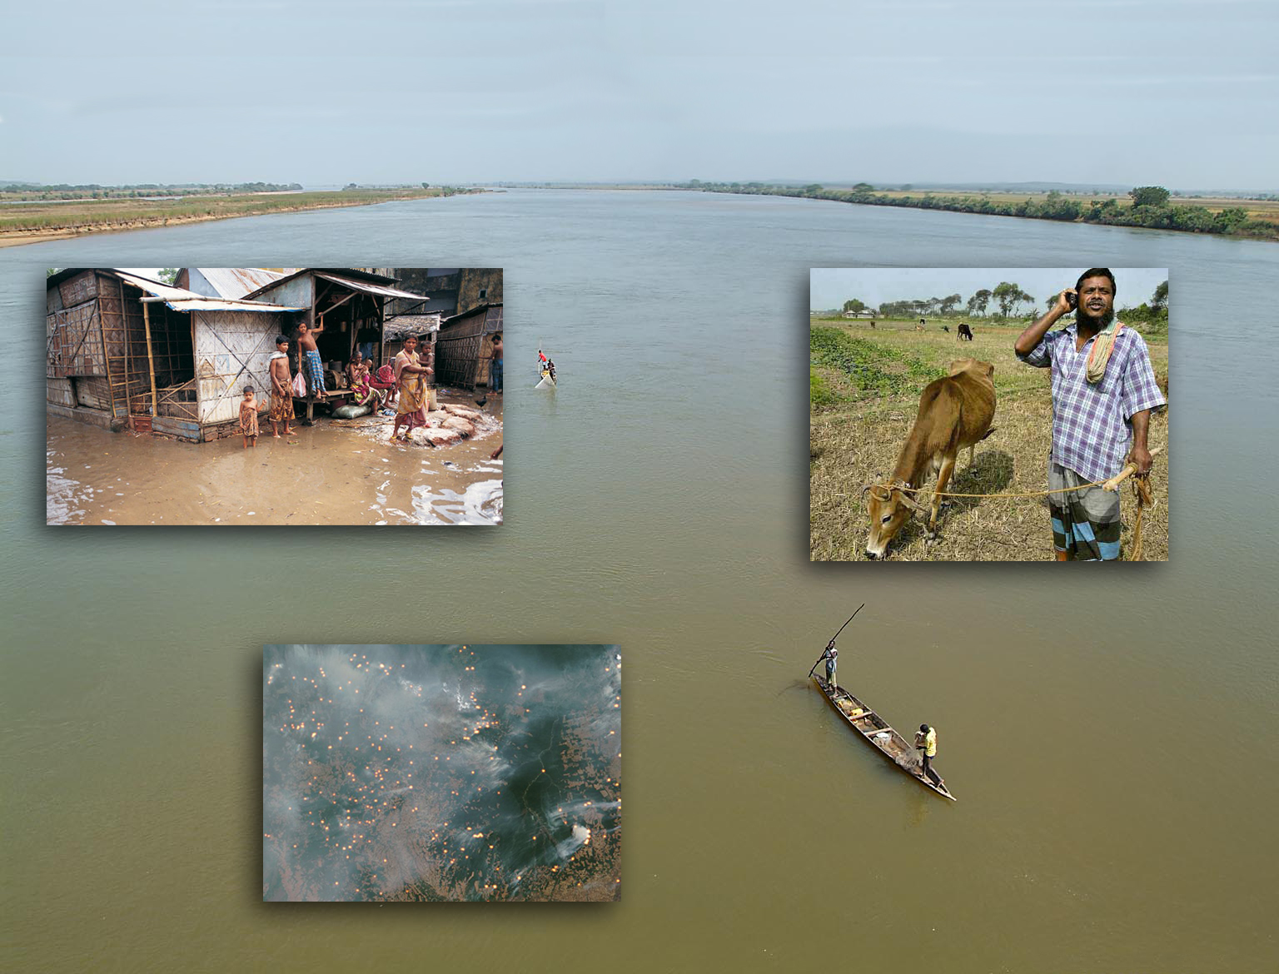
Relevance

Slide 5
Our Objective
World Resources Report 2010-2011 focuses on how national governments, particularly in developing countries, can integrate climate risks into current practices in an effort to increase the resilience of their communities and ecosystems.

Slide 6
Research activities
Case Studies: Vietnam, Bangladesh, Nepal, Namibia, China, Brazil, Indonesia, South Africa, Mali Mongolia, China, Rwanda
Expert perspectives: 56 expert papers and commentaries commissioned. Contributors from 36 countries.
Simulations: Ghana and Vietnam
Roundtables on information and coordination needs for adaptation

Slide 7
Types of Decisions that will be Affected
Sector | National-Level Decision Making Processes | Examples of Key Decisions
Agriculture | National Agriculture Plan Crop Management Plan | Irrigation vs. rain-fed cropping Introduction of new crop varieties Relocation of farm communities
Energy | National Energy Policy/Strategy | Fossil fuels vs. hydropower % of renewable generation Extending the grid vs. distributed generation
Natural Resources Management | Coastal Zone Management Plan Forest Management Plan Protected Areas Plan National Invasive Species Management Plan Management Plans for Marine and Recreational Fishing | Endangered/protected species How much and what areas to protect Maximum fish catchment Hard vs. soft coastal protection measures
Urban Planning/ Infrastructure | National Transportation Plan Road Maintenance Finance Plan National Highway Plan | The siting of bus rapid transit stations and other forms of mass transit Construction of bridges and highways
Water | National Water Policy Integrated Water Resource Management Plan | Expand watershed restoration programs River basin cooperative agreement Repair aging/leaking infrastructure Enhanced flood control infrastructure
Tourism | National Tourism Plan | Creation of ecotourism destinations
Cross-sectoral | Five-year National Development Plans National Adaptation Programme of Action | Identification of adaptation and development priorities Prioritization of sectors and populations

Slide 8
The Impacts Associated with a Changing Climate are Already Rapidly Changing our World
archive.constantcontact.com

Slide 9
The Impacts, Some of Which Will Be Irreversible, Necessitate Deep and Fast Cuts in GHG Emissions.
deq.virginia.gov

Slide 10
The Scale, Pace and Complexity of the Risks Posed by Climate Change Require a Different Approach to Decision Making than in the Past.
deq.virginia.go
completetrainer.co.uk

Slide 11
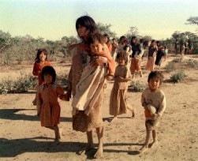
Vulnerability will Dictate How Climate Risks Translate into Impacts on the Ground.
obrar.org

Slide 12
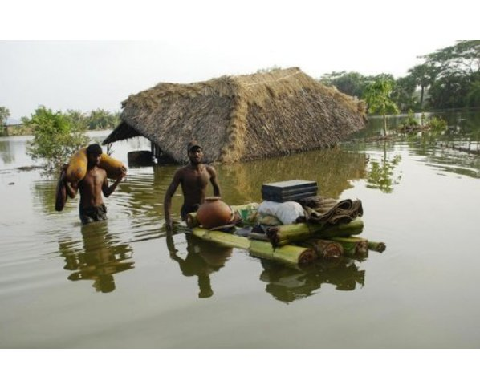
The Profound Risks Posed by a Changing Climate will Require Decision Makers to Make Difficult Choices.
allvoices.com

Slide 13
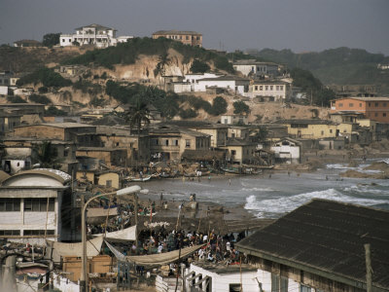
For Some Long-lived, Inflexible Decisions, Decision Makers will Have to Make Early Choices to Take Aggressive Action with Future Risks in Mind.
David Poole

Slide 14
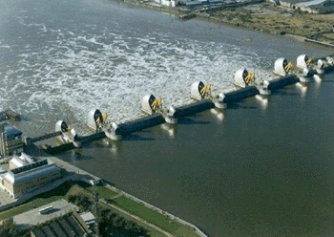
For Other Decisions, a Stepwise Approach can be Taken that Keeps Future Options Open and Avoids “Lock-in” of Future Vulnerability.
orangefrogproductions.com

Slide 15
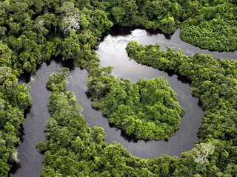
When Setting Priorities, Policymakers Should be Mindful of Thresholds and May Need to Adopt a More Proactive Approach.
ecolocalizer.com

Slide 16
Long-term Planning Must Respond to Changing Circumstances Given the Uncertainty of Future Climate Change.

Slide 17
Improved Design and Use of: Public Engagement; Information Systems; Institutions; Tools; and Resources Can Equip Planners and Policymakers to Make More Effective Decisions in a Changing Climate.

Slide 18
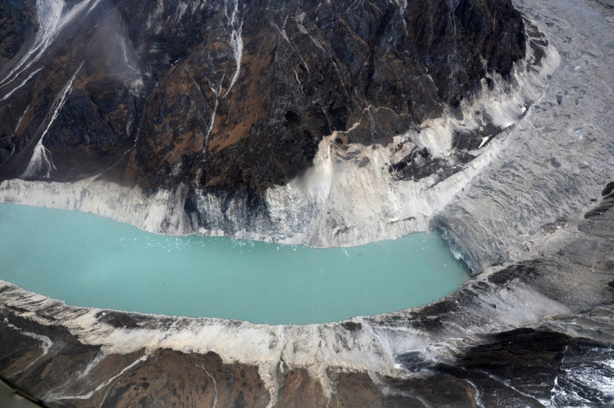
Public Engagement
Government-led activities may fail, and investments be lost, if communities are not actively engaged throughout the policy process, including in implementation and monitoring of efforts.
A glacial lake at Thulagi glacier, Manang Range, Nepal.

Slide 19
Public Engagement
Governments must convey to the public the scale and range of the risks and expected impacts that climate change will bring.
ccafs.cgiar.org

Slide 20
Information
While much attention has recently been paid to climate models, especially downscaling, investments into weather monitoring stations and other data collection systems are much needed.

Slide 21
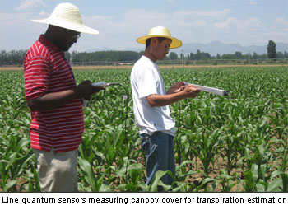
Information
Information management systems will need to be long-lasting and regularly updated.
www-naweb.iaea.org

Slide 22
Institutions
Coordination among national agencies and between national and local governments is key to effective responses to and preparation for climate change.
cubeking.wordpress.com

Slide 23
Institutions
Institutional mandates should be reformed to better contend with climate risks.
jscca.org

Slide 24
Tools for Planning and Policymaking
Existing tools can often be customized to serve adaptation planning and policymaking purposes by integrating climate risks and vulnerability into their use.
www.good.is

Slide 25
Tools for Planning and Policymaking
Decision makers should also seek out innovative tools that are especially useful for planning for short- and long-term climate risks.
vectorresearch.com

Slide 26
Resources
Targeted and sustained funding delivered through fit-for-purpose mechanisms will be critical for developing successful processes for adaptation.
americanprogress.org

Slide 27
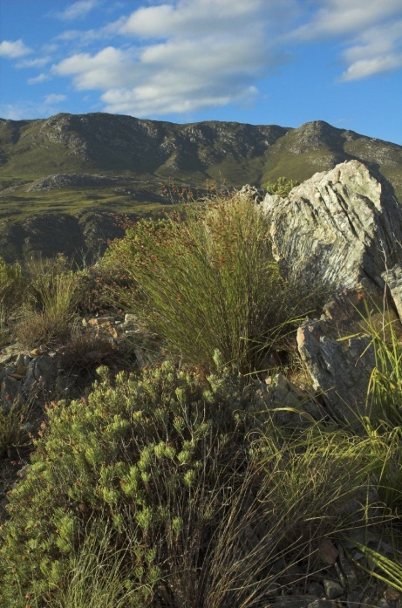
Resources
Ecosystems can help mitigate many natural hazards, such as storms, and maintaining them can be less costly than building expensive man-made infrastructure and provide co-benefits to society.

Slide 28
worldresourcesreport.org

