Slide 1
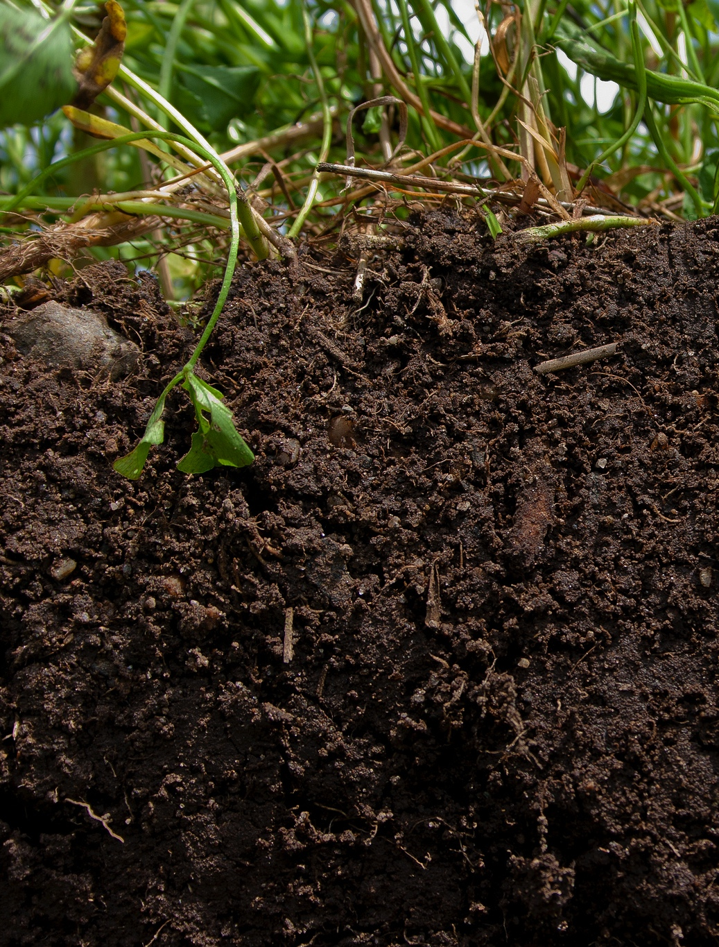
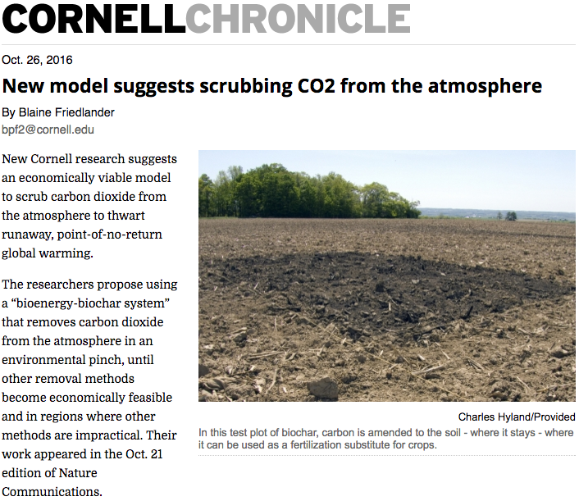
Cornell University @ COP 22
scs.cals.cornell.edu

