Slide 1
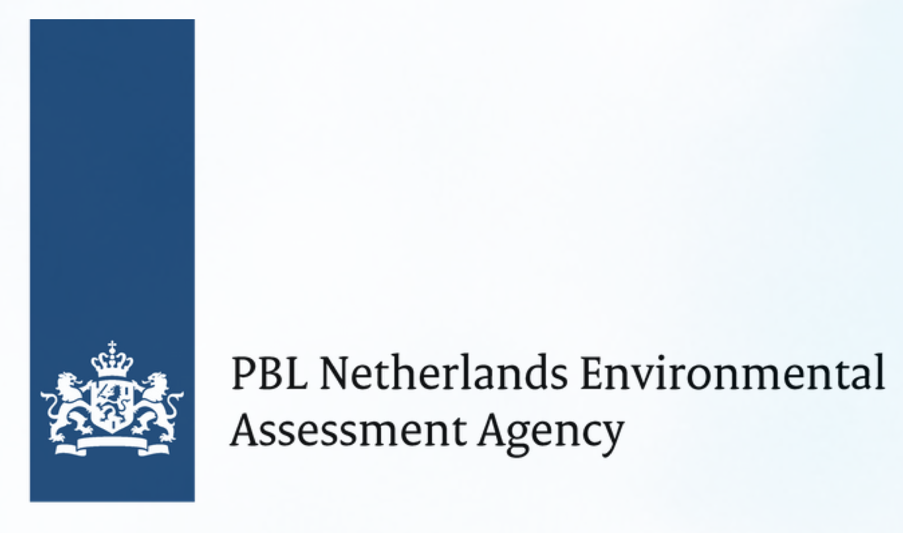
Advancing (I)NDC implementation and ambition: Bridging research & practice Monday, 7 November | 16:45 - 18:15 | Arabian
Niklas Höhne | NewClimate Institute | Moderation
Takeshi Kuramochi | NewClimate Institute | INDC preparation process and national climate policy planning
Michel den Elzen | PBL Netherlands Environmental Assessment Agency | Abatement costs of INDCs and of actions towards 2 °C and 1.5 °C
Fu Sha | National Center for Climate Strategy and International Cooperation of China | China's INDC implementation and global analysis
Nathan Hultman | Center for Global Sustainability, University of Maryland | Bridging research and practice to raise ambition
Discussion

