Slide 1
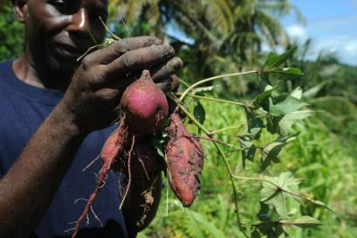
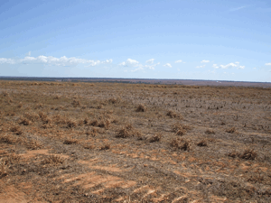
Blessing or Curse?
Climate Smart Agriculture -
Anika Schroeder, Climate Change and Development, COP 18, 2012

Slide 3
Climate Smart Agriculure
Agriculture that sustainably increases productivity,
resilience (adaptation),
reduces/removes GHG (mitigation) and
enhances national food security/ development goals.

Slide 4
CSA = Organic Agriculture?
 | CSA | Agroecology
Agriculture that sustainably increases productivity, | X | X
resilience (adaptation), | X | X
reduces/removes GHG (mitigation) | X | X
and enhances national food security/ development goals | X | X (even food souvereignity, livilihoods)
GMO | (X)
Pesticides | (X) | internal regulating mechanisms
Nitrogen Fertilizers | (X)
culturally adapted | (X) | X
Family / Community Farming | (X) | X
(?)
Notes:
Ever since its foundation in 1958, MISEREOR has strengthened the self-help capacity of farming communities, who are not merely passive recipients of aid but work hard to ensure their own livelihoods. Sustainable small-scale agriculture offers large numbers of people in rural areas food security and cash income. These farmers often produce the majority of food in a country, thus making a signifi cant contribution to the supply of staple foods to local and national markets. Compared to larger commercial enterprises, small farms often have higher productivity as a result of greater product diversifi cation and employ more labour.2 However, hunger remains rural and appropriate support for smallholders and landless people is urgent. Yet agricultural policies continue to be dominated by development models that promote rapid industrialisation
and export orientation. Small-scale farmers are excluded from support and often lose access to their land as a
result of land hunger for export oriented large-scale production.
Supporting sustainable agriculture is a useful development paradigm. Such a sustainable intensifi cation, however, need to be accompanied by a socio-economic, cultural and political shift towards farmer-centred development.

Slide 6
74% of all agricultural GHGs from developing countries (IPCC)
up to 90% of the total mitigation potential in agriculture through increased soil carbon sequestration (FAO 2009)
?

Slide 7
GHGs from developing countries?
China: 1,2 t per capita
Latest rise due to N2O in Annex 1
Soil carbon sequestration?
numbers do not include substitution of ind. Fertilizer, post harvest
losses, food waste and consumption patterns!
Sequestering = reducing emissions ?!

Slide 8
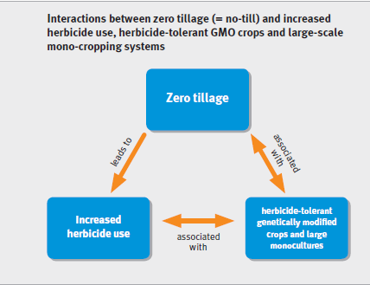
Pitfall 1: No-till

Slide 9
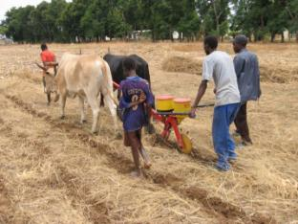
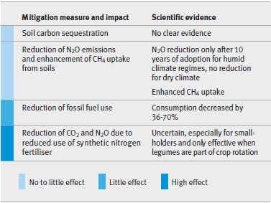
Pitfall 1: No-till
Notes:
ambivalent initiatives are already being pushed by industry lobbyists and policy-makers that follow the paradigm of industrialised agriculture – often disguised as best practices focussing on small producers – without any public debate on potential risks. Some companies and governments now promote blueprint technologies for food security and mitigation such as no-till (including genetically modifi ed organisms) and biochar.
But agricultural practices, and especially soils, are complex systems, intertwined with ecosystems and embedded in sociocultural
structures. The following papers of this folder show that such blueprints do not provide sustainable solutions. Furthermore,
the inclusion of climate-smart agriculture in carbon markets would divert funds and efforts from the support of sustainable
small-scale farming towards the quantifi cation of GHG emissions of soils to enable market-based approaches that can neither serve
the climate nor the people (see paper 2 in this folder).

Slide 10
Pitfall 2: Carbon Market
1. Undermining climate change mitigation
complex biological processes in soils and biomass make it difficult to obtain reliable soil carbon measurements – these, however, would be essential for the quantification of sequestered CO₂ and the generation of corresponding CERs
2. No benefit for small-scale farmers
upfront costs vary from US$ 12 to 600 per ha (FAO)
even where farmers manage to receive carbon credits intermediaries soak up most of the financial resources
Notes:
The experience gained with the CDM and other developments as well as scientific findings lead to the insight that the inclusion of agriculture in carbon markets would exclusively benefit large-scale farming and companies. Furthermore, it would be accompanied by an array of threats to the climate and to small-scale producers.
Undermining climate change mitigation
In current debates, the fact that carbon can only be stored temporarily is not seriously taken into account. Moreover, complex biological processes in soils and biomass make it difficult to obtain reliable soil carbon measurements – these, however, would be essential for the quantification of sequestered CO₂ and the generation of corresponding CERs (Muller et al. 2011). Offsetting fossil fuel emissions by sequestering CO₂ into soils and/or biomass is therefore a guessing game at the cost of global temperature rise and, consequently, at the expense of those most vulnerable to climate change.
No benefit for small-scale farmers
In CDM and other offsetting schemes the development and registration of projects is complicated and costly. In agriculture, an offset project developer would need to cover upfront costs, e.g. for negotiation with buyers of CERs or monitoring of activities and carbon budgets, that vary from US$ 12 to 600 per ha (FAO 2009). Therefore, mainly large landowners or agro-industry companies would be able to serve the carbon market. This could provide incentives for an expansion of large-scale agriculture. In countries where property rights are uncertain this could also lead to situations where revenues are captured only by those who have formal land titles, while communities and farmers with non-registered customary rights would remain excluded. If small-scale farmers planned to access the carbon market, they would need to aggregate a large number of farms into a ‘carbon pool’. But even where farmers would manage to receive carbon credits directly, the income would be extremely low as intermediaries would soak up most of the financial resources (The Munden Project 2011).
Proponents of soil carbon markets therefore claim that the main benefits for farmers are higher yields rather than direct income (Forest Trends et al. 2010). Indeed, some mitigation approaches in agriculture, such as agroforestry, can provide multiple benefits for mitigation, adaptation and poverty alleviation. But carbon offset projects in agriculture could also lead to a pressure on farmers to adopt a range of non-appropriate or even costly and controversial technologies to comply with the project, at the expense of locally appropriate, affordable and ecologically sound measures. The promotion of blueprint technologies (like biochar and no-till as illustrated in papers 4 and 5 of this folder) can increase farmers’ vulnerability to climatic extremes. There is also the risk of the displacement of food production in favour of more easily calculable carbon sinks (Pinto et al. 2010).
Diversion of funds
The FAO estimates that close to 17 billion euros are required between 2010 and 2030 to establish a system that enhances carbon trading from soil carbon sequestration, as there is a need to develop appropriate mitigation, monitoring, reporting and verifying methodologies to measure the amount of sequestered carbon and convert them into carbon credit equivalents (FAO 2009). This shows that carbon market ‘readiness’ projects may divert institutional, human and monetary resources away from other development efforts, as a large part of this cost will be met by Official Development Assistance (ODA).
Recommendations
MISEREOR rejects the inclusion of agriculture in carbon markets. UNFCCC parties should embark upon a separate and specific discussion on how to reduce the climate footprint of agro-industry by shifting to industrial practices that make ethical, environmental and economic sense in an era in which the finite nature of resources such as oil, phosphorus and land is becoming increasingly clear. The reduction of agricultural inputs such as nitrogen as fertiliser or pesticides that are produced with high energy input as well as the reduction of fodder imports such as soy are ecological viable and socially equitable options to reduce emissions from agriculture.
UNFCCC parties and organisations supporting food security, food sovereignty and development should engage in existing discussions, funds and programmes on adaptation for small producers rather than shifting the burden of mitigation towards the most vulnerable in the South.

Slide 11
Pitfall 2: Carbon Market
3. Non- appropriate technology
Introduction of non-appropriate technologies at the expense of locally appropriate, affordable and ecologically sound measures.
Risk of the displacement of food production in favour of more easily calculable carbon sinks (Pinto et al. 2010)
4. Diversion of ODA
17 billion Euros needed between 2010 and 2030 to establish trading from soil carbon sequestration
Carbon market ‘readiness’ projects may divert institutional, human and monetary resources away from other development efforts, as a large part of this cost will be met by Official Development Assistance (ODA)

Slide 12
Focus of current Climate Finance
US Dollar Million
see: www.climatefundsupdate.org

Slide 13
Where is the market?
Price: €5.5 and 1 € (CER)
adding non-permanent carbon credits into this unstable and unreliable scenario is likely to further undermine the price of carbon
reduces incentives to mitigate in Annex 1
no acceptance under the EU ETS
A guessing game at the cost of global temperature rise and, consequently, at the expense of those most vulnerable to climate change.

Slide 14
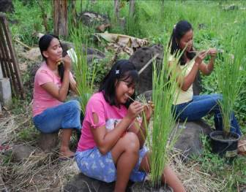
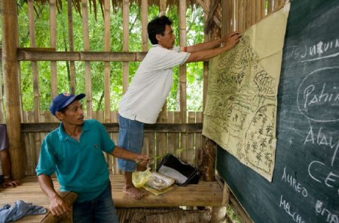
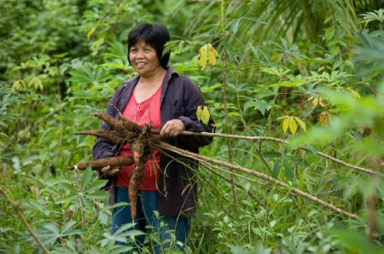
s
s

