Slide 1
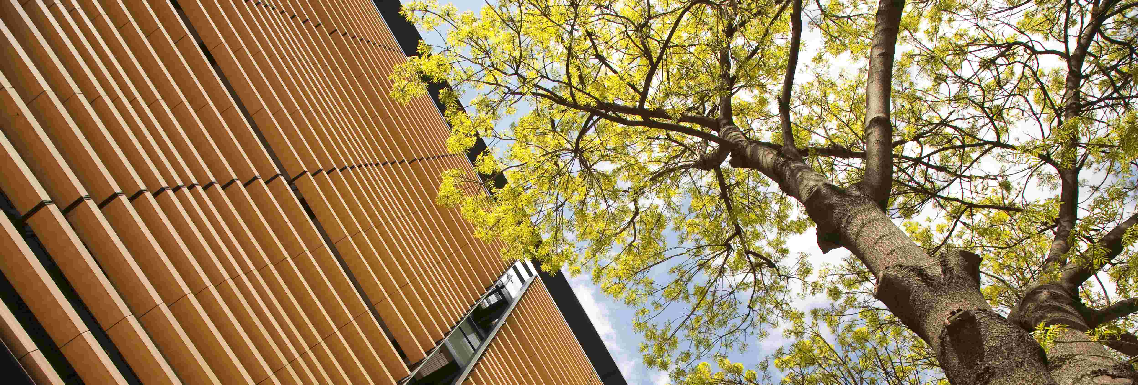
Marginal abatement cost curves: a call for caution Fabian Kesicki UN Climate Change Conference (SB 34) in Bonn, 7th June 2011

Slide 2
This presentation is based on the report ‘Marginal Abatement Cost Curves: a Call for Caution’ written by Ekins, P., Kesicki, F. and A. Smith
A research article of the same name is forthcoming in Climate Policy.

Slide 3
OVERVIEW
Concept of Marginal Abatement Cost (MAC) Curves
Policy Use of MAC curves
Shortcomings
MAC Curves and REDD (Reducing Emissions from Deforestation and Forest Degradation)

Slide 4
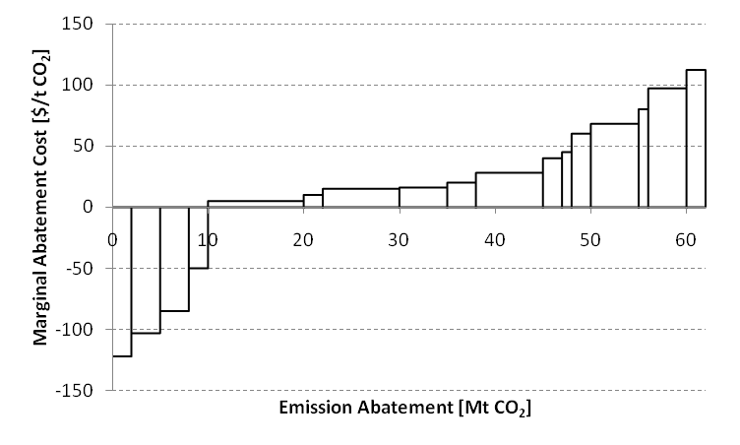
MAC CURVE CONCEPT
Electric heat pump
Gas CCS
Electric boiler
Coal CCS
Biomass
Solar PV
Geothermal
Offshore wind
Solar CSP
Efficiency improvement
Onshore wind
Cars plug-in
Nuclear
Cars full hybrid
Residential appliances
Insulation retrofit
Residential electronics

Slide 5
POLICY USE OF MAC CURVE
Many areas:
Electricity saving
Air pollution
Waste reduction
Water availability
Energy-related emissions reduction
REDD
Many countries:
USA, EU, UK, France, Mexico, China
REDD: Congo for example

Slide 6
PROBLEMS WITH CURRENT MAC CURVES
Unclear assumptions
Cost definition
Implementation barriers
Discounting
Intertemporal issues
Interactions / baseline emissions
Behavioural aspects
Ancillary benefits/costs
Handling uncertainty
Financial focus

Slide 7
ELECTRIC HYBRID CAR EXAMPLE
Parameter | Unit | Petrol ICE | Petrol Hybrid
Discount rate | % | 5 | 5
Lifetime | years | 12 | 12
Investment cost | € | 19600 | 22400
Operating cost | €/a | 1670 | 1732
Annual kilometrage | km/a | 14481 | 14481
Fuel consumption | l/100 km | 7 | 5.95
Petrol price | €/l | 1.68 | 1.68
Emission factor | kg CO₂/l | 2.3 | 2.3

Slide 9
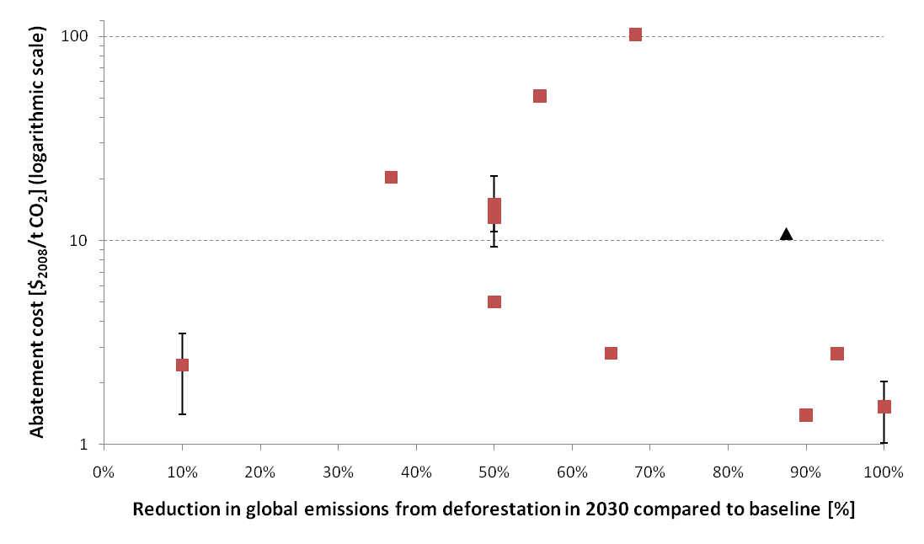
MAC CURVES AND REDD
Nabuurs et al. 2007
Kindermann et al. 2008
Eliasch 2008
Grieg-Gran 2008
Nauclér and Enkvist 2009
Kindermann et al. 2008
Stern 2007
Blaser and Robledo 2007
Holdren 2007
(Brazil only)

Slide 10
MAC CURVES AND REDD
Uncertainty concerning baseline emissions
Focus on opportunity cost without considering administration, implementation, monitoring costs
Price discrimination
Potential leakage
Interactions with demand for bioenergy, timber industry

Slide 11
CONCLUSIONS
MAC curves: simple and useful illustration tool; first, rough guide to abatement costs and potentials at a specific point in time
Previously outlined caveats may have been overlooked in the past
MAC curves should be applied very carefully in the REDD debate

Slide 12
Thanks for your attention Fabian Kesicki fabian.kesicki.09@ucl.ac.uk

