Slide 1
Case Study #3: Susie Ho Monash University (Australia) Dickson Ho Monash University (Australia) UNEP intern

Slide 2
Notes:
We were the first university to set an energy reduction target bac in 2005.
In 2017 Monash Committed to Net Zero emissions by 2030.

Slide 3
Net Zero Emissions - Implementation Plan
ENERGY
CAMPUS
ON-SITE
RENEWABLES
OFF-SITE
NET ZERO READY
BUILDINGS
INTELLIGENT
ENERGY NETWORK
OFFSET
EFFICIENCY
ELECTRIFICATION
RENEWABLES
RESIDUAL
EMISSIONS
Reduce energy
Consumption
Lighting
Façade
Appliances
Thermal Plant
Bldg Optimisation
Electricity becomes
our total energy
Consumption
Heat pumps replace gas boilers
Thermal Precincts
Maximise on-site
solar generation
Rooftop solar PV
Solar thermal
Purchase off-site
renewable energy
Net zero ready buildings
All electric
High performance building envelope
Controls
Micro-grid
Battery Storage
Offset residual
Emissions
Green Power
Carbon offsets
▪
Power Purchase
Agreement
Notes:
We have an ambitious strategy which are on track to deliver.

Slide 4
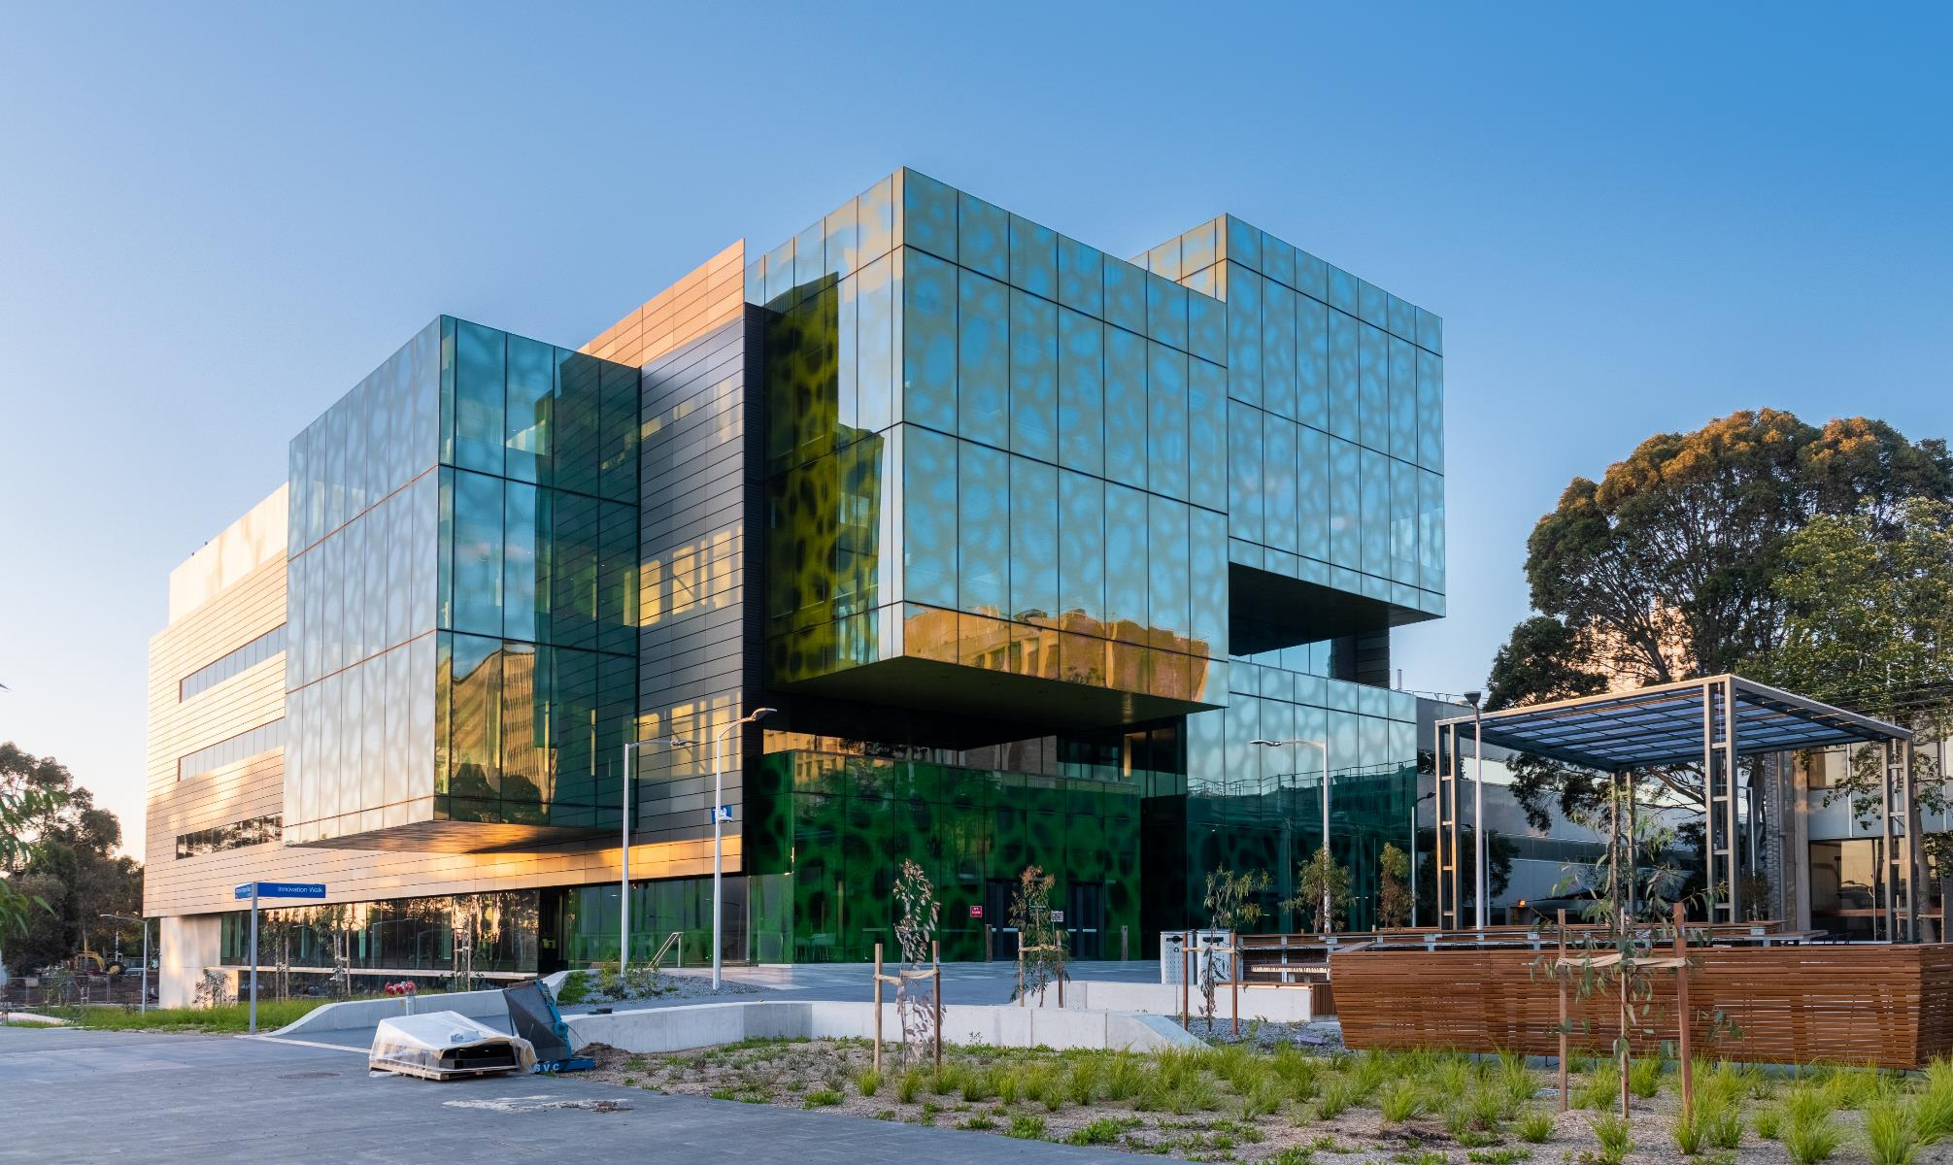
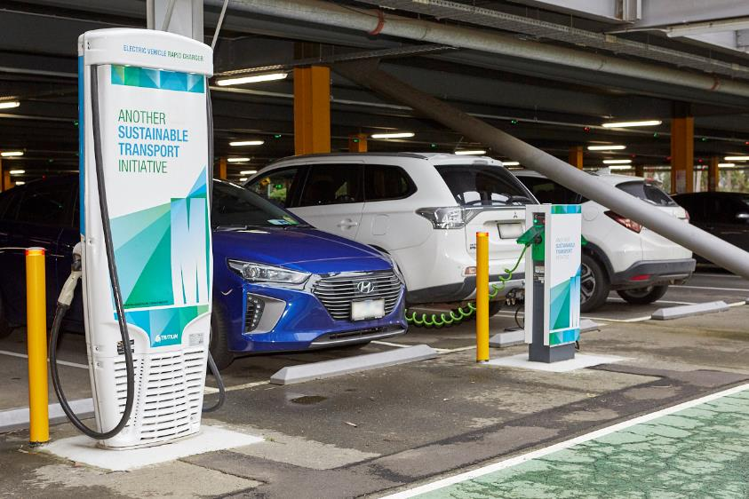
Campus Electrification
Thermal Plant
New builds incorporating all-electric thermal plant
Stage 1 - Electrification of Clayton Medicine, Engineering and Science precincts
EV Charging
3 x EV chargers installed at Clayton Campus
Broader rollout (on other campuses) currently being planned
Energy Efficiency
Building Optimisation
3 year building optimization program (24 buildings)
LED Lighting Upgrades
16, 500 fixtures at end of 2018;
43,000 by 2020, 45 Buildings

