Slide 2
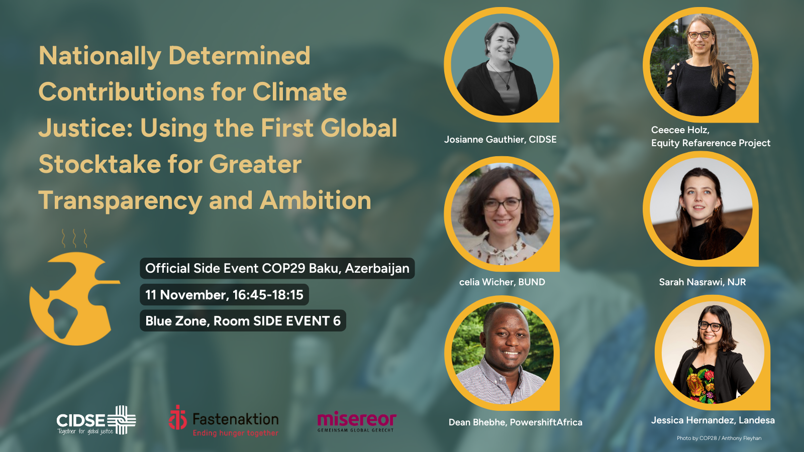

Slide 3
AGENDA
Introduction by Moderator – Josianne Gauthier, CIDSE
Keynote on the CSO equity review by Ceecee Holz, Climate Equity Reference Project
Reaction and panel discussions Youth, climate justice and NDC by Sarah Nasrawi, Dutch National Youth Council – NJR NDC Transparency and the role of CSOs by Celia Wicher, BUND Climate justice ambition by Bhekumuzi Dean Bhebhe, PowershiftAfrica Land rights in updated NDCs by Jessica Hernandez, Landesa
Q&A session – Open discussions from the floor
Wrap up and close – Josianne Gauthier, CIDSE

Slide 4
Lydia Machaka – machaka@cidse.org
THANK YOU!
Get in touch
Notes:
Mention something on the use methodology – same TOR, based on research… etc

