Slide 1
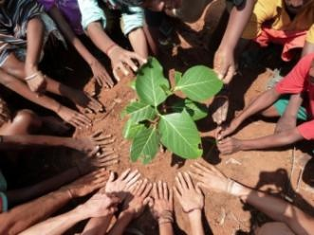
Importance of Tree Planting in Africa: The Role of African Youths

Slide 2
Africa is the continent expected to suffer most from shifting climate zones and droughts, like the one now in its fourth year in East Africa.
Destroying trees through burning contributes to global warming, releasing about 370 million tons of greenhouse gases every year — about 5 percent of the world total

Slide 3
According to Late Wangari Maathai, a Kenyan environmentalist and Nobel Peace Prize winner, She called on people around the world to plant 1 billion trees, which according to her is an effort in which an ordinary citizens can fight global warming.
Her major concern was that people should ensure the trees thrive long after they are planted, according to her “It’s one thing to plant a tree, it’s another to make it survive,”
The main campaign is meant to inspire ordinary citizens to help the environment

Slide 4
DESERT ENCROACHMENT
Is a natural phenomenon which can also be caused by man through massive felling of trees.
Most states from northern Nigeria in swampy savannah and Sahel areas live under serious threats from desert encroachment and ecological problems. Those living in Sahel region are the most affected because the weather is harsher there.
Desertification in the north according to experts has been attributed largely to excessive exploitation of the forest resulting in the exposure of dry sandy soil, of the semi arid areas to strong winds during the dry season.

Slide 5
Typical desert encroachment

Slide 6
Plant a Tree today!

Slide 7
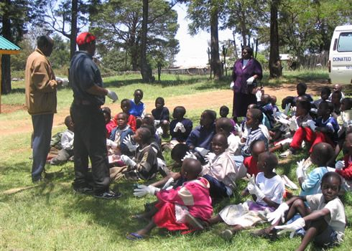
Catching them young on tree planting

Slide 9
Advantages of Tree Planting
“One acre of forest absorbs six tons of carbon dioxide and puts out four tons of oxygen. This is enough to meet the annual needs of 18 people.” —U.S. Department of Agriculture

Slide 10
Planting trees greens and beautifies the areas in which they are planted.
Forests remove an enormous amount of carbon from the atmosphere; 57 percent of the carbon emitted by human beings is absorbed by ecosystems and the ocean.
Deforestation, on the other hand, contributes between 12 and 20 percent of the world’s annual greenhouse gas emissions - about the same as the transport sector, according to the Intergovernmental Panel on Climate Change (IPCC) - making it the second-largest source of emissions caused by humans.

Slide 11
Trees planting in Africa is more effective in removing carbon from the atmosphere and regulating the climate
Trees planting can also help address the developmental needs of marginalized forest-dwellers, providing sources of livelihood such as fruit tree cultivation, the collection of medicinal plants, or even the sustainable harvesting of wildlife meat

Slide 12
Other benefit of tree planting
It provide jobs for the young men in the tree nursery.
The majority of the people raise livestock and harvest gum from the gum trees, When those gum trees mature the whole community will profit from them.
Trees play a vital role in rural and urban populations. They are needed to enrich and anchor soil, to maximise water supplies, to beautify and humanise townships and urban areas and to provide shade and shelter. They are also crucial for biodiversity conservation. Products and services from trees include food, timber, fibre, medicines and energy

Slide 13
Neighborhoods with well-shaded streets can be up to 6–10° F cooler than neighborhoods without street trees Neighborhood. Street trees provide shade for streets and parking areas, add to the value of property, cool the air, and absorb carbon dioxide.

Slide 14
Case Study in Nigeria: The Neem tree:

Slide 15
The Neem tree:
The neem tree for many people, particularly in the northern Nigeria, is one of the most economic trees you can find anywhere because apart from using it to reduce the effects of desertification , It was discovered in the last 10 years that there are so many things that can come out of the tree.
Neem oil, soap, detergents and paint:
The neem oil, which is sold all over the world and used by most cosmetic industries, is a byproduct of the neem tree. The neem seed when crushed, produces one of the best cosmetic oils anywhere in the world. There are other byproducts that come out of making the oil and many of them are being used at the moment for making soap.
In fact, we have a soap-making industry in Makuda, Kano State where the crushing neem seeds is done to get the oil. And then also, detergents for controlling pests. Lately it was found that a good part of local paints used all over the north for painting mud houses, are also byproducts of the neem tree. You can just go on and on

Slide 16
AMUWO ODOFIN INITIATIVES

Slide 19
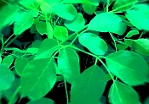
(SPECIAL FOCUS) Moringa Tree

Slide 20
MORINGA was one the greatest gifts which Nature bestowed on man - this was known to the ancient world and they regarded the tree as a “Cure-all Tree”. They also saw the moringa tree as“ the Tree of Immortality”, “the Tree of Life”, “the Never Die Tree”, “the Miracle Tree that brings harmony to life”, and “Mother’s best friend”.
Parts of the Tree Used:
The whole plant, the leaves, the stems, the bark, the roots, the immature pods, the seeds, the flowers, and the flowering tops.

Slide 21
Moringa seedlings after two weeks

Slide 22
A road path with Moringa trees

Slide 23
The Gorgeous and Green Benefit
The Gorgeous and Green Benefit is a fundraiser for the Planting for Peace; 155 Million Tree Campaign, which aims to fight the ravaging effects of climate change in Nigeria.

Slide 24
The College of Agriculture and Veterinary Services (CAVS) on behalf of the University of Nairobi, joined the rest of the world in celebrating World Environment Day on June 5, 2012, by planting 3000 trees. This year's theme was: Green Economy - Does it include you?

Slide 25
Trees also serve the purpose of overall air quality enhancer, and a much needed one at that. They provide natural habitats for many small creatures, and reduce the temperature by providing shade. All in all, a tree is not just a beautiful creature standing amongst the many phenomenal settings of this world, it is a powerful and vital tool that directly ensures our survival.

Slide 26
Thank you
Taiwo Adewole (B.sc, M.sc)
taiwoadewole@yahoo.com
+2348023354679,+23470672031060

