Slide 1
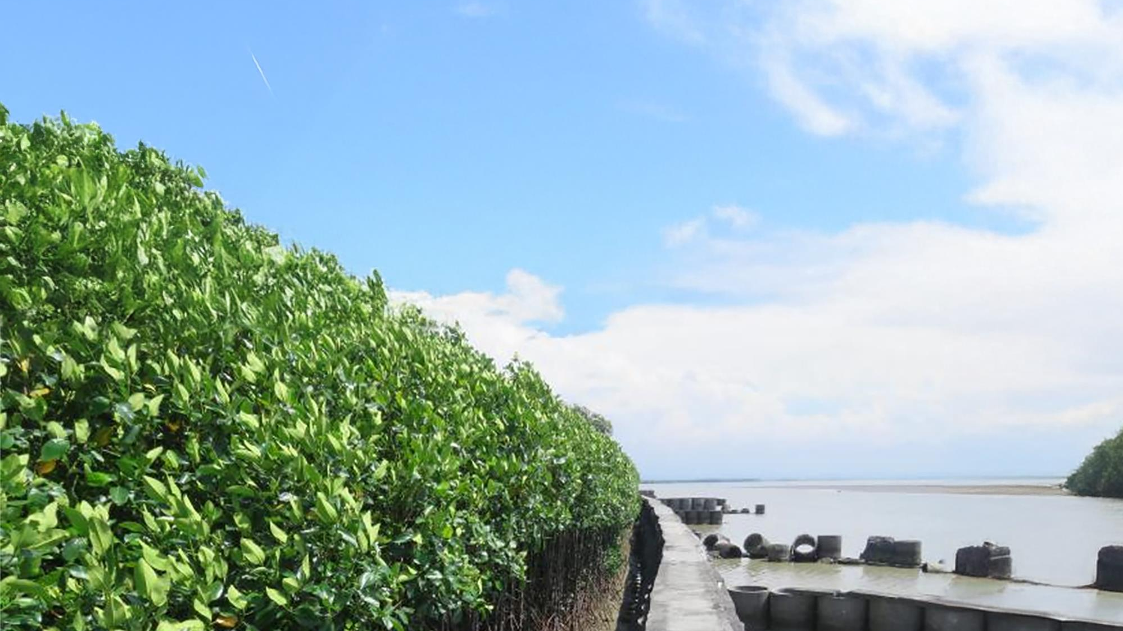
UNFCCC-MDB
Side Event @COP29
Adaptation Finance Reimagined:
Fresh Perspectives for Lasting Impact
16 November | 13:15-14.45 hrs | UN Side Event Room 5
Presenter
Youssef Nassef, UNFCCC
Panelists
Gianpiero Nacci, EBRD
Yasser Ibrahim, MIGA
Hilen Meirovich, IDB Invest
Garett Phillips, AFDB
Moderator
Julija Polycarp , AIIB

