Slide 2
Businesses Initiatives on Climate Change (IEC)
In 2011, the main Brazilian Businesses Initiatives on Climate started to meet in order to:
Align themes and agendas of each initiative;
Seek synergies in their actions, and
Propose joint actions towards a low carbon economy.
This group is composed by:
Climate and Energy Thematic Chamber (CEBDS)
Business for Climate Platform (GVces)
Brazilian Industry Network on Climate Change (CNI)
Climate Forum – Entrepreneurial Actions on Climate Change (Instituto Ethos)

Slide 3
Side Event Agenda
20.15 About Businesses Initiatives on Climate (IEC)
Climate and Energy Thematic Chamber (CEBDS)
Brazilian Industry Network on Climate Change (CNI)
Climate Forum – Entrepreneurial Actions on Climate Change (Instituto Ethos)
Business for Climate Platform (GVces)
20.50 Brazilian Business Cases Presentation
Vale
Votorantim
21.10 Brazilian Government Positioning on Carbon Management
Embassador André Corrêa do Lago
21.40 International book launch “Climate Change in Brazil: economic, social and regulatory aspects”

Slide 4
CEBDS – BCSD-Brazil
Created in March, 1997 – gathers 64 of the biggest Brazilian companies, that together represent more than 40% of Brazil GDP and employ more than 600 thousand direct jobs.

Slide 5
BCSD-Brazil Associated Businesses

Slide 6
CEBDS – BCSD-Brazil
Created in March, 1997 – gathers 64 of the biggest Brazilian companies, that together represent more than 40% of Brazil GDP and employ more than 600 thousand direct jobs.
Integrate the WBCSD global network, that gathers 60 national councils around the world, representing about 200 companies.

Slide 7
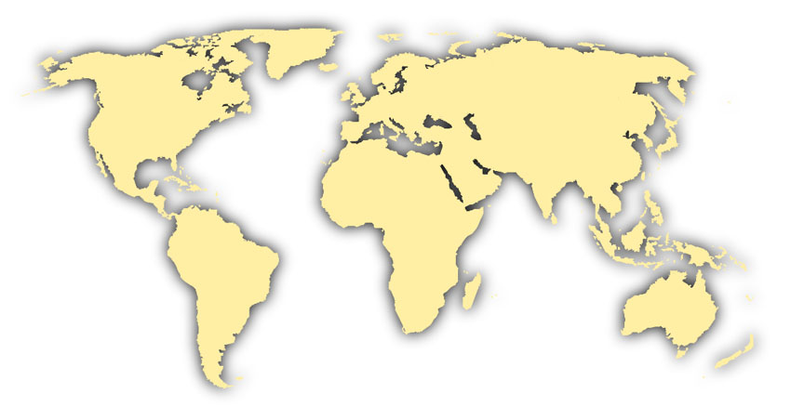
Network of Regional Offices
- BCSD and Partner Organizations -
The Excel
Partnership Canada
NHO-Norway
Vernadsky Foundation Russia
CGLI USA/Canada
BCSD UK
BCSD Czech Republic
EPE France
BCSD Austria
BCSD Mongolia
US BCSD
FFA Spain
BCSD Croatia
BCSD Korea
Entorno Spain
BCSD China
Keidanren Japan
BCSD Mexico
BCSD Gulf of Mexico
APEQUE
Algeria
AEEC
Egypt
BCSD Kazakhstan
CentraRSE Guatemala
CII
BEC Hong Kong
BCSD Honduras
AED Costa Rica
BCSD Thailand
BCSD Taiwan
BCSD El Salvador
BCSD Nigeria
CoRE BCSD India
BCSD Colombia
BCSD Venezuela
BCSD
Sri Lanka
PBE Philippines
BCSD Ecuador
BCSD Malaysia
Perú 2021
EFZ Zimbabwe
BCSD Bolivia
BCA
Australia
BCSD Brazil
FEMA Mozambique
WASIG
W.Australia
BCSD Paraguay
BCSD Argentina
BCSD South Africa
BCSD New Zealand

Slide 8
CEBDS – BCSD-Brazil
Created in March, 1997 – gathers 64 of the biggest Brazilian companies, that together represent more than 40% of Brazil GDP and employ more than 600 thousand direct jobs.
Integrate the WBCSD global network, that gathers 60 national councils around the world, representing about 200 companies.
BCSD-Brazil was the first Brazilian institution to talk about sustainability using the Triple Bottom Line concept.

Slide 9
BCSD-Brazil Thematic Chambers
Business Adaptation on Climate Change
BCSD-Brazil
Climate and Energy
Sustainable Finance
Sustainable Constructions
Biodiversity
Water
Legislation
Sustainable Management
Communication and Education
Carbon Management on Suply Chain

Slide 10
Side Event Agenda
20.15 About Businesses Initiatives on Climate (IEC)
Climate and Energy Thematic Chamber (CEBDS)
Brazilian Industry Network on Climate Change (CNI)
Climate Forum – Entrepreneurial Actions on Climate Change (Instituto Ethos)
Business for Climate Platform (GVces)
20.50 Brazilian Business Cases Presentation
Vale
Votorantim
21.10 Brazilian Government Positioning on Carbon Management
Embassador André Corrêa do Lago
21.40 International book launch “Climate Change in Brazil: economic, social and regulatory aspects”

Slide 11
COP 17 Side Event:
Business Initiatives for Carbon Management in Brazil
Paula Bennati
Coordinator
Brazilian National Confederation of Industry
Environment and Sustainability Department
Durban , South Africa
2nd December 2011
Notes:
Slide relacionando os serviços prestados

Slide 12
Brazilian Industry Network on Climate Change
Virtual platform
Originated from the Business Mobilization Group on Climate Change (2008)
Notes:
Slide relacionando os serviços prestados

Slide 13
Brazilian Industry Network on Climate Change
Main objectives
To improve the flexibility to exchange information
To better coordinate the different sectors of industry
To identify priority issues, trends, risks and opportunities in climate change agenda
To promote low-carbon practices
Notes:
Slide relacionando os serviços prestados

Slide 14
Brazilian Industry Network on Climate Change
Main principles
The Industry is aware of its important role in the country’s transition to a low carbon economy
The Industry supports the implementation of the National Policy on Climate Change
The commitments to reduce GHG must ensure the competitiveness of national industry
Notes:
Slide relacionando os serviços prestados

Slide 15
Brazilian Industry Network on Climate Change
National Policy on Climate Change
Law nº 12.187/2009
National voluntary commitment for the reduction of GHG emissions from 36,1% to 38,9% of the projected emissions by 2020 (art. 12)
Notes:
Slide relacionando os serviços prestados

Slide 16
Brazilian Industry Network on Climate Change
National Policy on Climate Change
Main considerations
Availability and price of energy are critical to industrial competitiveness in a globalized world
Financial incentive mechanisms should be available before the implementation of the reduction emission commitments
Notes:
Slide relacionando os serviços prestados

Slide 17
Brazilian Industry Network on Climate Change
National Policy on Climate Change
Main considerations
Brazil needs to raise the consumption patterns of its population and therefore their living standards Brazil also needs to ensure a fair and socially acceptable transition, defending its competitiveness and competitive advantages
Notes:
Slide relacionando os serviços prestados

Slide 18
Thank you!
Paula Bennati
pbennati@cni.org.br
+55 61 3317-8860
Notes:
Slide relacionando os serviços prestados

