Slide 1
THE DRAFT GLOBAL PACT FOR THE ENVIRONMENT
and PARIS AGREEMENT SOME REMARKS ON SYSTEMIC RELATIONSHIP
Prof. Maria Magdalena Kenig-Witkowska
University of Warsaw
m.kenig_witkowska@wpia.uw.edu.pl
Prof. Maria Magdalena Kenig-Witkowska
University of Warsaw
m.kenig_witkowska@wpia.uw.edu.pl
Photo credits: Mitch Meyers, Unsplash

Slide 2
How the DGPE emerged. Its objectives, codified principles and monitoring mechanism
Relationship between the DGPE and other environmental agreements
The DGPE as an instrument contributing to the process of achieving the PA’s objectives

Slide 3
Photo credis: Carly Rae Hobbins, Unsplash

Slide 4
How the draft Pact emerged
DGPE was prepared by the “Group of Experts for the Pact”, an international network of over one hundred world-renowned specialists in environmental law representing more than forty nationalities, chaired by Laurent Fabius, President of the French Constitutional Council.
The work was coordinated by the Environment Commission of the „Club des Juristes” with the French Constitutional Council.
On May 10, 2018 the resolution opening the negotiations towards the Global Pact for the Environment was adopted by the UNGA by a very large majority. A special ad hoc Open-ended Working Group, open to the NGO participation is established to discuss inter alia options to address possible gaps in international environmental law and environment-related instruments.

Slide 5
The draft Pact – objectives
The draft Pact reflects the approach to the fundamental principles of law which had been elaborated by an international group of experts representing different legal cultures and, importantly, coming from countries with very different ecosystems.
The DGPE was designed to facilitate its implementation in national policies and, as a result, in the provisions of national law.
An attempt was made to achieve a balance between rights and obligations, taking many circumstances into account. This is why its objective range covers not only States, but also non-state actors which have an important role to play in the implementation of environmental law.

Slide 6
The three main objectives
of the Pact:
To become a vehicle for harmonization and consistency of international environmental law and to be a means of minimizing the effects of normative proliferation of multilateral environmental agreements.
As a document with binding force, it will strengthen the codified principles, constitute a source of legal certainty and also consolidate the existing standards of the principles of international environmental law.
To codify a globally recognized right to live in an ecologically sound environment.

Slide 7
Photo credits: Kace Rodrigue, www.kacerodriguez.com, Unsplash

Slide 8
Construction of the draft Pact
The construction of the draft Pact is an example of the classic structure of a multilateral international agreement.
The preamble gives the basic reasons for creating the draft Pact. Among others, it mentions the growing threats to the environment and the need to respond to them at the global level to ensure better protection of the environment.
The preamble also recalls the mutual linkages between environmental protection and human rights, the protection of the rights of the indigenous population, as well as intergenerational and intragenerational justice. It underlines the role of non-State actors in environmental protection and recalls the vital role of women in achieving sustainable development goals. It emphasizes the fundamental role of science and education.

Slide 9
Photo credits: Tomás Muñita/www.internationalrivers.org

Slide 10
21 codified principles laid down in the provisions under the following titles:
Article 1 – Right to an ecologically sound environment;
Article 2 - Duty to take care of the environment;
Article 3 – Integration and sustainable development;
Article 4 – Intergenerational equity;
Article 5 – Prevention;
Article 6 – Precaution;
Article 7 – Environmental damages;
Article 8 – Polluter-Pays;
Article 9 – Access to information;
Article 10 – Public participation;
Article 11 – Access to environmental justice;
Article 12 – Education and training;
Article 13 – Research and innovation;
Article 14 – Role of non-State actors and subnational entities;
Article 15 – Effectiveness of environmental norms;
Article 16 – Resilience;
Article 17 – Non-regression;
Article 18 – Cooperation;
Article 19 – Armed conflicts;
Article 20 – Diversity of national situations;
Article 21 – Monitoring of the implementation of the Pact.

Slide 11
An overview of the draft principles
Article 1 and, at the same time, the first pillar of the draft Global Pact for the Environment codifies the right to live in an ecologically sound environment. In addition to the duty to take care of the environment, this right is one of the two pillars of the Pact.
Article 2 provides for the duty to take care of the environment. In light of its provisions, every State or international institution, every person, natural or legal, public or private, has the duty to take care of the environment.
Article 3 is devoted to the principles of integration and sustainable development. It provides that the Parties to the Pact are obliged to integrate the requirements of environmental protection into all their policies at their planning and implementation stages, at national and international levels.
Article 4 represents an ambition to gain a horizontal influence on environmental law, since it provides that the principle of inter-generational equity affects decisions concerning the environment.
Article 5 provides that States have the duty to ensure that activities under their jurisdiction or control do not cause damage to the environments of other States or in areas beyond the limits of their national jurisdiction.

Slide 12
An overview of the draft principles
Article 6 is devoted to the principle of precaution, applicable to the situation where due to a lack of scientific certainty a given issue falls within the range of a potential risk.
Article 7 concerns damage done to the natural environment, providing that the necessary measures should be taken to remedy environmental damage.
Article 8 concerns the liability under the “polluter pays” principle (PPP), which means that the polluter must bear the costs of pollution.
Articles 9, 10 and 11 apply to procedural commitments related to access to information, decision-making and access to justice in environmental matters.
Article 12 concerns the obligation to ensure education and training on the protection and improvement of the environment.
Article 13 is to achieve a similar objective. Indeed, it lays down the obligation to promote research on ecosystems and the introduction of innovations in this scope.

Slide 13
An overview of the draft principles
Article 14 establishes an essential role of non-State actors and local entities in the implementation of the principles of environmental protection under the Pact. It provides that the Parties to the Pact should take the necessary measures to encourage non-State actors, civil society, economic actors, cities and regions to participate in the process of environmental protection.
Article 15 addresses in general terms the obligation of the State-Parties to ensure the effectiveness of environmental norms.
Articles 16 and 17 represent the efforts by the authors of the Pact to promote the principle of progressive and forward-looking (in view of the emergence of new technologies) development of environmental law, among others, by codifying the principle of strengthening of the capacity of ecosystems to recover - the principle of resilience (art.16)) and the principle of non-regression (art.17).

Slide 14
An overview of the draft principles
Article 18 reaffirms the obligation to cooperate for environmental protection at the global scale.
Article 19 extends the principle of environmental protection to the situations of armed conflicts.It provides that States should take measures to protect the environment in the course of armed conflicts, in accordance with the norms of universal international law governing these matters.
Article 20 codifies the principle of common but differentiated responsibilities. It provides that the special needs of developing countries, particularly the least developed and those in a special situation because of their “environmental” conditions, should be taken into account. Furthermore, it provides for the application of the principle of common but differentiated responsibilities and respective capabilities, in light of different national circumstances.

Slide 15
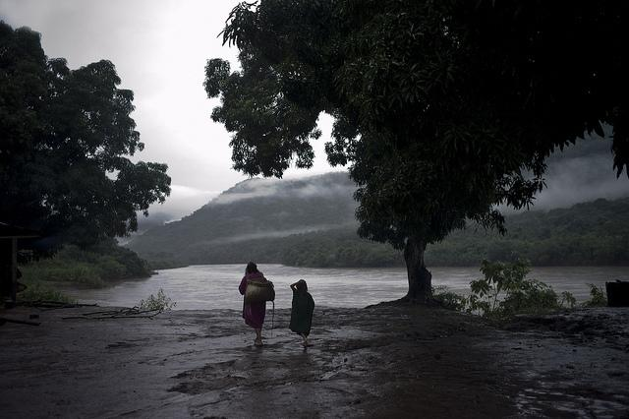
Photo credits: Tomás Muñita, www.internationalrivers.org

Slide 16
Monitoring mechanism
Under Article 21, the committee of independent experts is established.
Its task is to facilitate the Parties’ implementation of the obligations laid down in the Pact, instead of the imposition of penalties and the use of court procedures.
Such a solution ensures the necessary flexibility, the capacity to adapt and the effectiveness of the implementation of the principles laid down in the provisions of the draft Pact.
The mechanism directly refers to the so-called compliance mechanism applied in international environmental law.
The emergence in treaties of special procedures to be applied in case there is a discrepancy between State practice and the provisions of a treaty is considered to represent progress towards achieving the effectiveness of the norms of environmental law.

Slide 17
Non-compliance procedures
Consists of at least two elements which give them an advantage:
They enable the launch of pre-emptive measures by identifying problems of compliance or non-compliance with norms, and
Place emphasis on the remedial element, as a result of which, States are quite keen to make use of such mechanisms.

Slide 18
Photo credits: Maxim Medvedev, Unsplash

Slide 19
Relationship between the Draft Pact for the Environment and other Environmental Agreements
The Draft Pact is not designed to replace existing environmental treaties. As a legally binding instrument of international law it will strengthen the codified universally recognized principle of international environmental law;
The Draft Pact is to provide an overarching umbrella of principles for the specific agreements. Therefore, it will be a new multilateral treaty coexisting with already concluded agreements.

Slide 20
Relationship between the Draft Pact for the Environment and other Environmental Agreements
The Draft Pact does not contain any conflict clause in case of incompatibility with deferent agreements. This issue can also be specified in the course of negotiations;
The relations between the Draft Pact and other environmental agreements are governed by principles of the Law of Treaties (1986 Vienna Conventions).

Slide 21
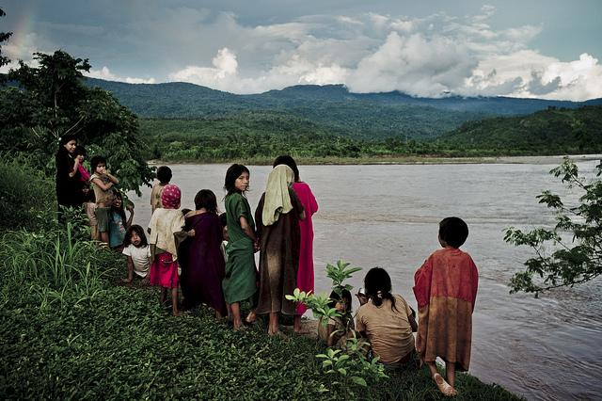
Photo credits: Tomás Muñita, www.internationalrivers.org

Slide 22
The Draft Global Pact for the Environment as an instrument contributing to the process of achieving the Paris Agreement’ objectives
There is a genetic relationship between the DGPE and the PA;
The Paris Agreement would then be analyzed as declensions of general principles included in the DGPE in relations to climate change issues;
The right to the ecologically sound environment and the duty to care enshrined in the DGPE will assure a more holistic approach in the process of implementation of the PA;
The DGPE will bring considerable added value to PA implementation process in terms of norm accessibility, legibility and legal certainty;
The DGPE will provide clearer direction for adjudicators as a convenient source of well-settled principles, providing the background for more specific provisions of Paris Agreement.

Slide 23
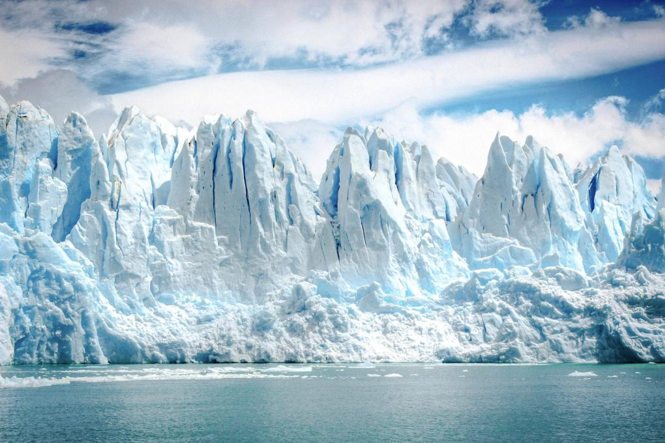
Photo credits: Alto Crew, altocrew.com, Unsplash

Slide 24
Some most frequently issues raised by critics
The debaters raised the issue that too much significance was attributed to the binding force of the Pact and somewhat skipped the issue of the effectiveness of implementing its provisions.
The question arises whether the provisions of the Pact should reflect the rights and obligations of the Parties to the Pact or, more broadly, codify international law?
It should be noted that the Pact does not provide for any mechanisms for resolving disputes arising from its interpretation and application.

Slide 25
Some most frequently issues raised by critics
The question arises whether the Pact should directly govern the behaviour of individuals.
Article 1 provides for the right to live in an ecologically sound environment. The question arises whether this right is to be complied with by each Party to the Pact with respect to their own citizens or also with respect to the citizens of the other Parties to the Pact?
Some debaters pointed out its fairly general wording, the absence of reference to its implementation and also failure to provide for the institution of an individual complaint in this regard.

Slide 26
Some most frequently issues raised by critics
The question about the relationship between the Pact and other sectoral agreements has also been asked.
One of the most often asked questions concerns the possible options of States’ attitudes to the proposed Pact.
How can it help implement the Paris Agreement?

Slide 27
Thank you !
Photo credits: Isabella Jusková, Unsplash

