Slide 1
LEDS Cooperation: Indonesia’s Perspective
Farhan Helmy Secretary of Mitigation Working Group National Council on Climate Change -Indonesia (DNPI)
Bonn, 18 May 2012

Slide 2
Outline
Climate Change Policy Dynamics: How to mainstream Low Emission Development Scenarios into National Development Plan
Low Carbon Initiatives and Exercises: Lesson Learnt
Potential s Abatement Cost
Low Emission Development Growth Strategy (LCGS)
Population Dynamics and Climate Change
Promotion on Regional Cooperation

Slide 3
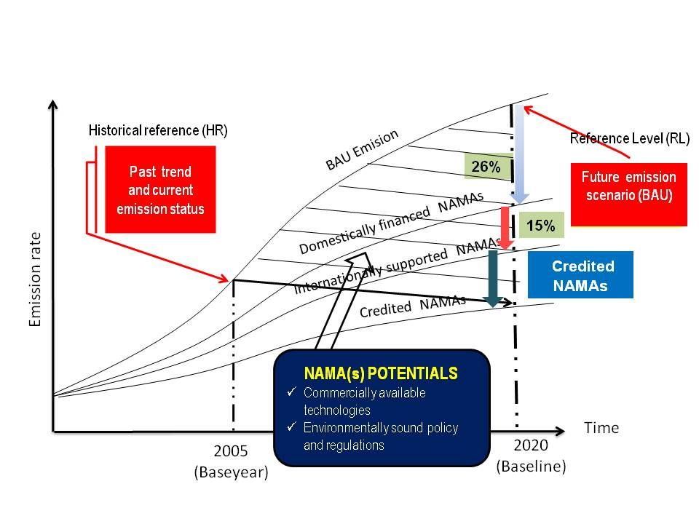
Mitigation Potentials and LED. Related Key Issues should be resolved in wide spectrum basis through framing the dialogue, stakeholder engagement and consensus, and MRV as a governance instrument → LED is an “Institutional Transformation” Issue.
Framing the Dialogue
To establish BAU baseline which is multi-sectoral business as usual as a basis for national mitigation actions: domestic (26%), international seeking support(15%) and credited NAMAs
To select effective and efficient mitigation actions(least abatement cost) through integrated and inclusive processes at national and sub-national levels.
To establish effective and efficient financial schema: public-private, market/non-market
“Proof of Concept” in the framework of low carbon economy (LCE)/sustainable development
Stakeholder Engagement and Consensus on policy and technical issues
Ministries/line agencies, NGOs, etc.
Governance
MRV as a means to measure commitment and performance
MRV as a means to facilitate coordination and planning, i.e database development
NAMAs – National Appropriate Mitigation Actions
Notes:
Indonesia is in the process to finalize Indonesian NAMAs through National Integrated Processes: 26% (domestically supported NAMAs, through domestic market and non-market), additional 15% (41%) as internationally supported NAMAs, and beyond 41% through market.

Slide 4
Emission Reduction Targets. Indonesian emission is expected to increase from 1.72 to 2.95 GtCO2e (2000-2020). Proposed National Action Plan on GHG Emission Reduction(RAN-GRK) consist of 70 programs distributed among various sectors .
Sectors | Emission Reduction Plan (Giga ton CO2e) |  | Agency
 | 26% | 15% (total 41%)
Forestry and Peat Waste Agriculture Industry Energy and Transportation | 0.672 0.048 0.008 0.001 0.038 | 0,367 0.030 0.003 0.004 0.018 | Ministry of Forestry, Ministry of Environment, Ministry of Public Works, Ministry of Agriculture Ministry of Public Works, Ministry of Environment Ministry of Agriculture, Ministry of Environment Ministry of Industry Ministry of Transportation, Ministry of Energy and Mining, Ministry of Public Works
 | 0.767 | 0.422

Slide 5
Climate Change Policy Dynamics
Presidential Instruction No. 10/2011 on Forest Moratorium. Development of REDD+ schemes including Indicative Moratorium maps
Presidential Decree No. 25/2011 on National Task Force for REDD+ REDD+agency and related institutional development (finance and MRV)
Presidential Regulation No. 61/2011 on National Emission Reduction Plan (RAN-GRK). Covering 70 programs for 26/41% emission reduction plan across five main sectors(agriculture, forestry and peat, energy and transportation, industry, waste and other supporting activities)
Presidential Regulation No. 71/2011 on National GHG Inventory System .Regular information on th level, status and trend of GHG emission change and absorption, including national, and subnational carbon stock as well as GHG emission reduction
President Regulation on Spatial Planning: Kalimantan (Presidential Regulation 3/2012)

Slide 6
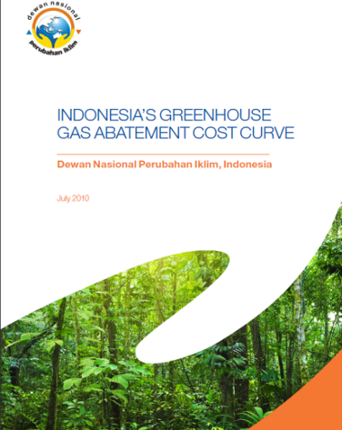
Macro Level Assessment : We have identified ways to reduce as much as 2.3 Gt CO2e in cuts by 2030, using existing technologies. Put another way, we have identified specific ways (entirely executed, are to cut as much as 70 percent of our emissions by 2030.)
Reduction possibilities
150 different measures have been identified that can be executed by the government, private sector and the community, which if all activated, add up to this 70 percent of total emissions in 2030.
The five biggest opportunities to reduce emissions are: 1). to prevent deforestation (570 Mt) (2). to prevent fires on peatland (310 Mt) (3). - to prevent oxidation of peatland through water management and rehabilitation (250 Mt) (4). - to implement and enforce sustainable forest management (SFM) (240 Mt) (5). to reforest marginal and degraded forests (150 Mt)
Better management of Indonesia’s land holds the key to cutting emissions and improving economic planning. It offers the possibility of reducing emissions by 1.9 Gt CO2e by 2030.
Notes:
We have identified ways to reduce as much as 2.3 Gt CO2e in cuts by 2030, using existing technologies. Put another way, we have identified specific ways (entirely executed, are to cut as much as 70 percent of our emissions by 2030.). BUT unfortunately most of the

Slide 7
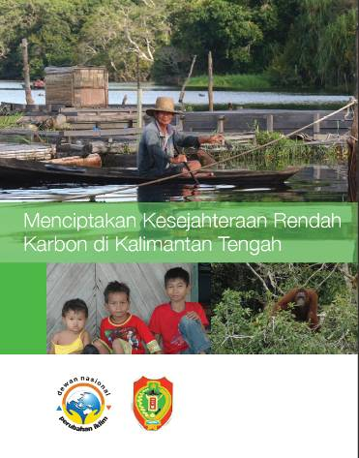
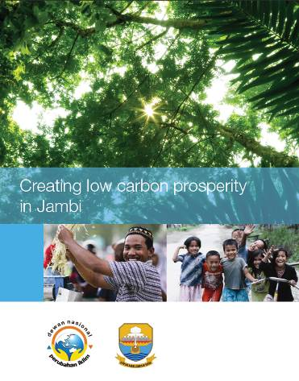
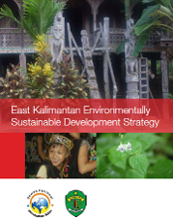
Low Carbon Growth Strategies (LCGS). Exercises have been undertaking in developing low carbon growth plan in three provincial governments shows that Low carbon growth thinking has not been reflected in the traditional spatial planning process
Key Elements:
Sustainable economic development strategy
Competitive strengths and weaknesses
New sources of growth
Sector strategies
Abatement opportunities, pilot projects, policies required
Palm oil, forestry, agriculture, coal, oil & gas
District strategies
District’s size and land use
Emissions and potential for abatement
GDP and employment
Implementation and enablers
Detailed action plan
Critical enablers required
Estimate of total costs
Notes:
FINDINGS
Spatial planning may lead to a new process that embody values of openness, empowerment, inclusiveness as well as knowledge sharing towards community engagement on various potential options of low-carbon path development. ROLE: (1) A comprehensive spatial provide the means to measure and monitor the changes (2). Spatial planning allows aggregate cross-disciplinary information about individual locations in seeking sustainable production and consumption options that influence interrelationship (3). As a means to build consensus among stakeholders.
Ideas of Low Carbon Development: (1). There is a potential window of opportunity in driving economic growth while mitigating GHG emission reduction (2). Low carbon growth thinking has not been reflected in the traditional spatial planning process (3). Approved spatial plans and the ones being under discussion will maintain those provinces on high deforestation pathways
Community Engagement (1). Create a culture of openness in tacking the issues and mitigation options (2). Build a platform of participation through overarching approach:(1) policy dialogue, tools, community engagement and public awareness (3). Foster the dialogue and continual improvement

Slide 8
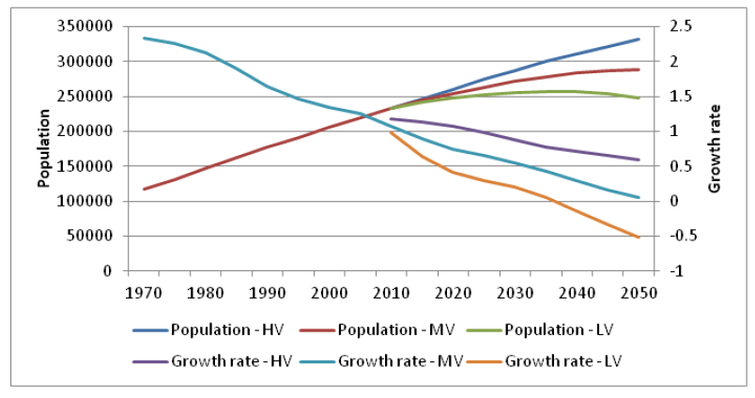
Populati on Dynamics . We have identified a number of population-based policy options for reducing GHG emissions which we believe merit further development and implementation: on Dynamics:
Source: DNPI, BKKBN, UNFPA (2012), Policy Memo, “Population Dynamics and Climate Change in Indonesia”
Enormous improvements can be made in energy efficiency in urban areas by better evidence-based spatial planning and allied interventions.
Revitalizing the national family planning program can make a major contribution to Indonesia’s GHG mitigation efforts over the next 40 years, and beyond.
Investing heavily in the education of today’s youth is an essential component of a successful mitigation strategy and a smooth transition to a green economy.
Much can be done to promote – especially among the young and rising middle class – the benefits of green choices and sustainable lifestyles to help reverse the current steep rise in the country’s carbon intensity.

Slide 9
Knowledge sharing on LEDS. We have been initiating and actively involving in various networks at national and regional levels to share ideas, experiences, potential collaborations.
Series of Policy and Technical Dialogue: MRV, low carbon economy, policy and modelling, expert briefings on mitigation related issues, geo-spatial technology, 100 villages mapping initiative; green investment, innovation and productivity; service reform dialogue on CC(SEREDI)
Indonesia Carbon Update Network (ICU-Net, www.indonesiacarbonupdate.net) low carbon economy, green Innovation, policy and assessment, geospatial technology, knowledge Warehouse, open source initiative, MRV and ICU-net portal(www.indonesiacarbonupdate.net)
Sapporo Initiatives: strategic integrative research in the framework of low carbon economy; integration of science and capacity building efforts in economy-wide climate change mitigation research; geo-spatial technology; a new approach on mobilizing and deploying financial/technical resources (GO, private)
Asia Forum on Carbon Update (AFCU-Net, www.afcunetwork.net): networking and collaborative efforts on low carbon economy, technology and capacity building for scientific communities in the Asian region.
University Network on Climate Change: 19 universities, Trans Kalimantan University (more than 100 universities)
South East Asia Network on Climate Change Focal Points(SEAN-CC), UNEP.
Indonesia Climate Change Center (ICCC) (US-Indonesia Comprehensive Partnership), www.iccc-network.net
East Asia Carbon Partnership on Low Carbon Society

Slide 10
Promotion of Regional Cooperation
Encouraging strategic integrative research in responding to the immediate demand of climate change actions at regional, national and sub-national level, e.g REDD+, energy security
To utilize all related forum to elaborate and strengthen cooperation, including South-south Cooperation, and intensify development of indigenous technology to form a climate resilience society.
Policy information exchange and database development. A robust and comprehensive technical and scientific information is needed to fill the gaps among the models, particularly in the targeted areas that are significant emission contributor through data “collation”, “collection” and consensus building.
Establishing Expert Group in responding challenging demand from national and sub-national level in the region
Linking LEDs into investment. A need for practical exercises on how we engage private/industry and other key stakeholders in a significant assessment.

Slide 11
Thank You!!
Thank

