Slide 1
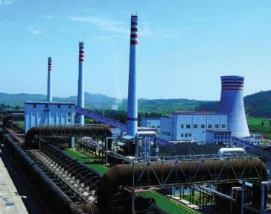
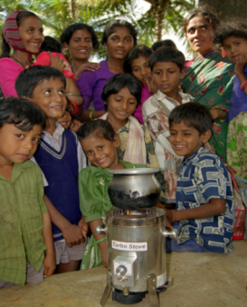
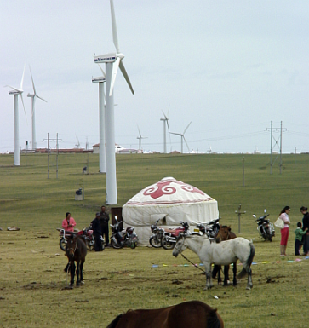
GEF Experience in Technology Transfer in Climate Change Mitigation
Zhihong Zhang
GEF Side Event at COP 16
December 2, 2010

Slide 2
Mandate of the GEF
Severs as an operating entity of the financial mechanism of the UNFCCC (and other global environmental conventions)
A partnership of 182 member countries along with the private sector and civil society
10 GEF implementing and executing agencies
MDBs: World Bank and regional development banks
UN agencies: UNDP, UNEP, FAO, IFAD, and UNIDO
Provides grant and concessional financing for projects in developing countries and economies in transition that protect the global environment while promoting sustainable development

Slide 3
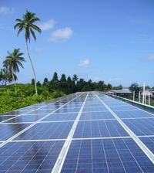
Financing Technology Transfer to Address Climate Change
GEF invested in about $3 billion in over 150 countries since 1991
Mitigation
Technology Needs Assessments
National Communications to the UNFCCC
Largest multilateral public-sector technology transfer mechanism
Financed demonstration, deployment, diffusion, and transfer of environmentally sound technologies

Slide 4
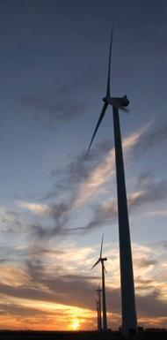
Financing Innovative Technologies and Practices
Leader in financing new, emerging low-carbon technologies
Hydrogen fuel-cell bus (FCB)
Concentrating solar power (CSP)
Pioneer in promoting market-based approaches and innovative financial instruments
Energy service companies
Partial risk guarantees

Slide 5
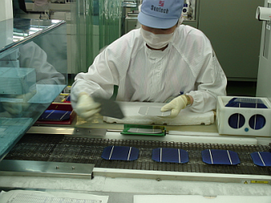
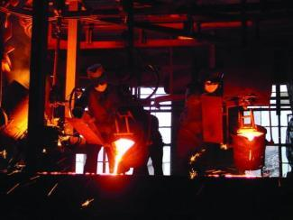
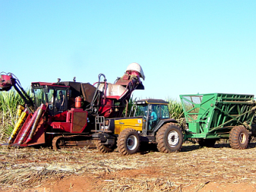
COP Mandate to GEF on Technology Transfer
Poznan Strategic Program on Technology Transfer (COP decision 2/CP.14)
Support for Technology Needs Assessments
Support for Technology Transfer Pilot Projects
Dissemination of successfully demonstrated technologies and know-how
GEF-5 replenishment
$4.3 billion total (six focal areas)
$1.4 billion for climate change mitigation

Slide 6
Technology Development Cycle and Innovation Chain

Slide 7
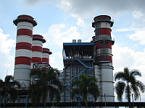
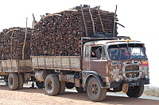
Strategic Objectives for GEF-5 (2010-14)
Demonstration, deployment, and transfer of innovative low-carbon technologies
Market transformation for energy efficiency in industry and the building sector
Investment in renewable energy technologies
Energy efficient, low-carbon transport and urban systems
Conservation and enhancement of carbon stocks through sustainable management of land use and forestry
Enabling activities and capacity building

Slide 8
Supporting Technology Transfer in GEF-5

Slide 9
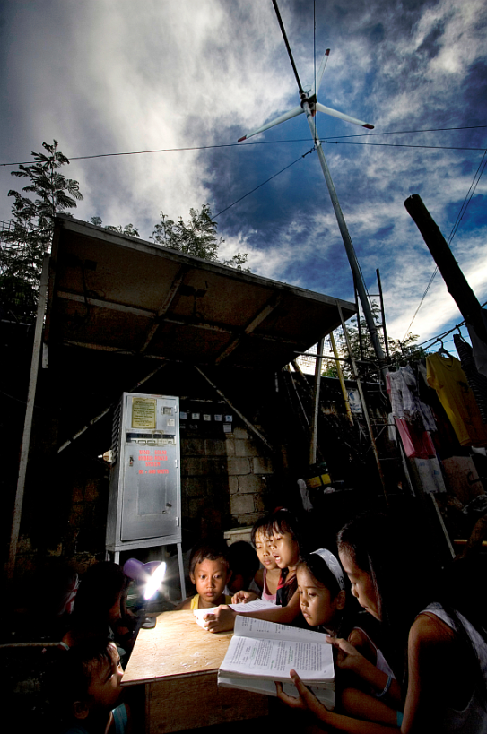
Contact Information
Zhihong Zhang, Ph.D.
Coordinator for Climate Change Mitigation
Email: zzhang2@thegef.org
Tel: 202-473-9852
Website: www.TheGEF.org

