Slide 1
Financing the Project
GEF a grant of 50 Million US$ to cover a substantial part of the incremental cost in comparison to the least cost conventional alternative producing the same annual amount of the electric energy.
JBIC a soft loan to finance the thermal portion of the plant by about 10.665 + 6.44 Billion JPY.
NREA will cover the local currency portion required for the project

Slide 2
Project Description
The plant will have a capacity of about 140 MW_{e}, out of them from solar sources of about 20 MW_{e} combining with a conventional fossil fuel portion of about 120 MW.
The solar island consists of a parabolic trough solar field with total area about 130800 m² capable of generating about 147 GWh_{th}/a of solar heat at a temperature of 393°C, the related Instrumentation and Control (I&C) and control room and the heat transfer fluid (HTF) system .
The combined cycle island will consist of one gas turbine with ISO rating of about 79 MW_{e}, one heat recovery steam generator (HRSG), one steam turbine of about 76.5 MW_{e}, and solar heat exchanger capable to absorb about the solar heat, plus all associated balance of plant equipment.

Slide 3
Technical Design
Stack Exhaust
Stack Exhaust
Stack Exhaust
100
100
°
°
C
100
C
395
°
C
395
°
°
C
395
C
°
C
Steam
Steam
Steam
540
540
°
°
C, 100bar
540
C, 100bar
°
C, 100bar
Solar HX
Solar HX
HRSG
Air and
vapour
Steam
Steam
Steam
G ~
Cooling
turbine
turbine
turbine
Tower
Tower
Air
Air
Condenser
Condenser
Condenser
Parabolic
Parabolic
Parabolic
295
295
295
°
°
°
C
C
Trough Field
C
Trough Field
Trough Field
600
600
°
°
C
C
G
G
G
G
Electricity
Electricity
~
Electricity
~
~
~
to the grid
to the grid
to the grid
Gas turbine(s)
Gas turbine(s)
Gas turbine(s)
Solar Island
Solar Island
CC Island
Integrated Solar Combined Cycle Power Plant “ISCCS”

Slide 4
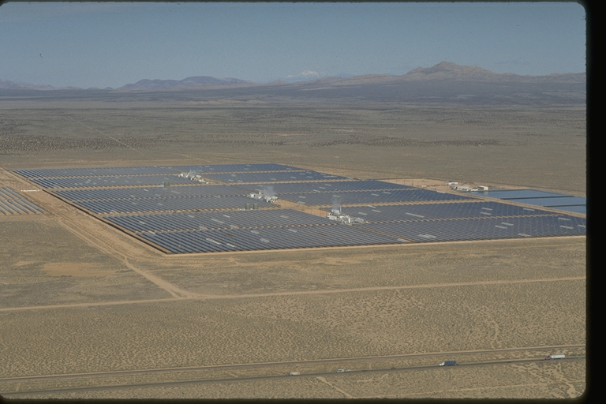
Project Technical Parameters
Summary of Technical Parameters
20 | Capacity of solar portion (MWe)
131 | Solar collectors area (1000 m²)
79 | Nameplate capacity of gas turbine (MWe)
76.5 | Nameplate capacity of steam turbine (MWe)
852 | Net electric energy (GWhe/a)
33 | Solar electric energy (GWhe/a)
4% | Solar share(%)
10000 | Fuel saving due to the solar portion (T.O.E / a)
20000 | CO₂ reduction (T/a)
Notes:
4

Slide 5
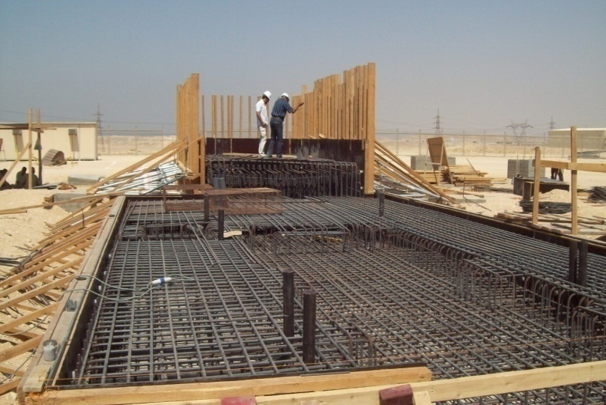
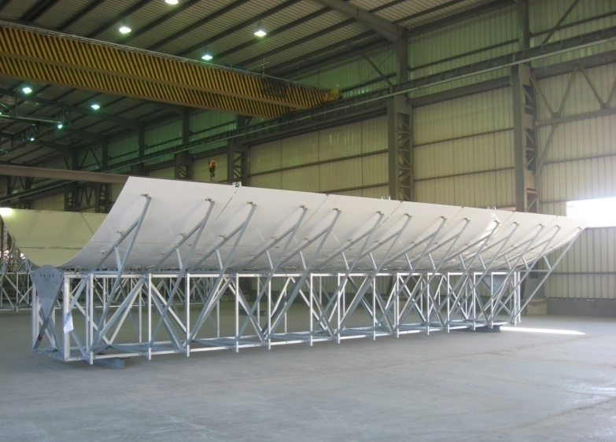
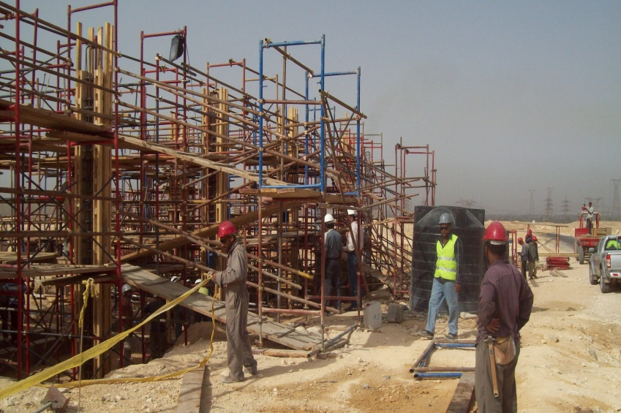
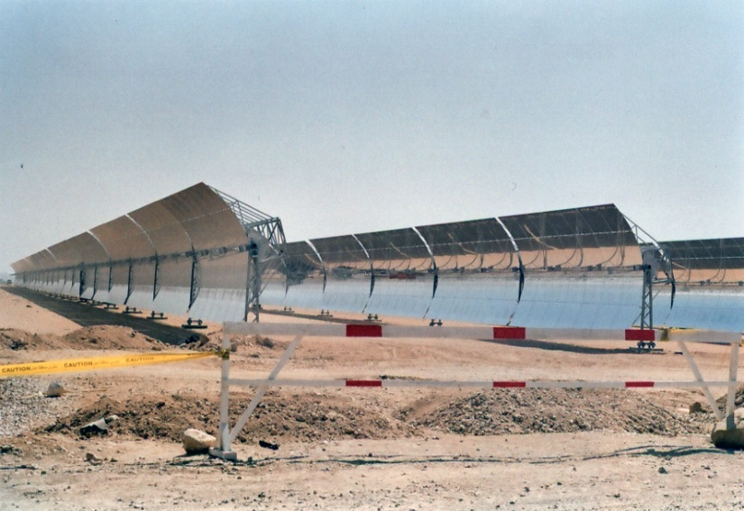
Project Construction

Slide 6
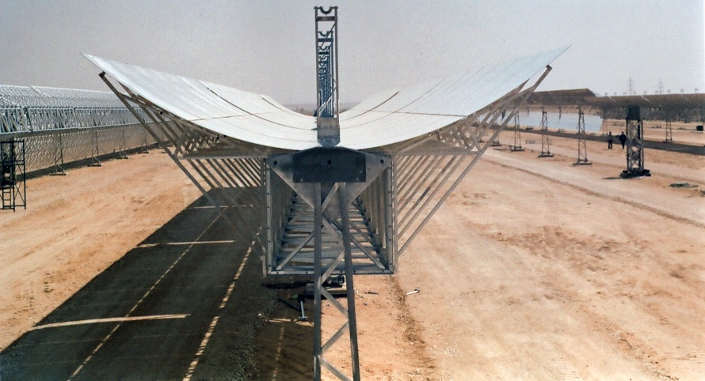
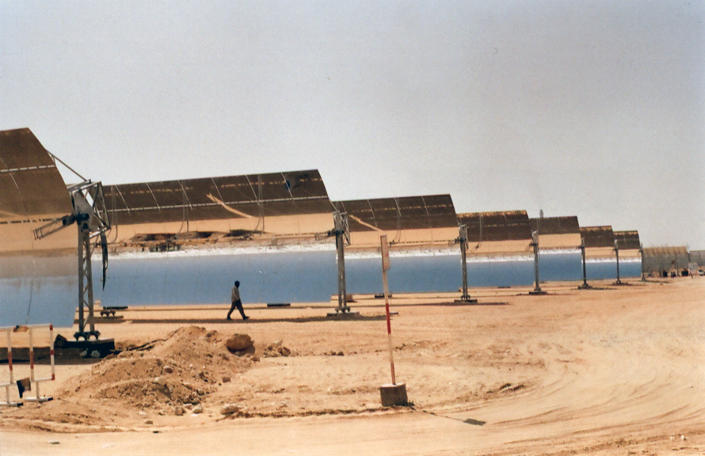
Project Construction

