Slide 1
Expected supply and demand under the Effort Sharing Regulation
Side Event EU Effort Sharing Flexibility Mechanisms: intra-Member State transactions and green investments
Jakob Graichen

Slide 2
Background
EU’s 2030 GHG targets:
Total GHG: 40% domestic reduction below 1990
ETS: 43% reduction below 2005
Effort Sharing: 30% reduction below 2005
Effort Sharing Regulation (ESR)
Covers housing, transport, agriculture and waste (all emissions not included in the ETS except LULUCF and international transport
Binding annual targets for each Member State
2030 target mainly distributed according to wealth (solidarity mechanism)

Slide 3
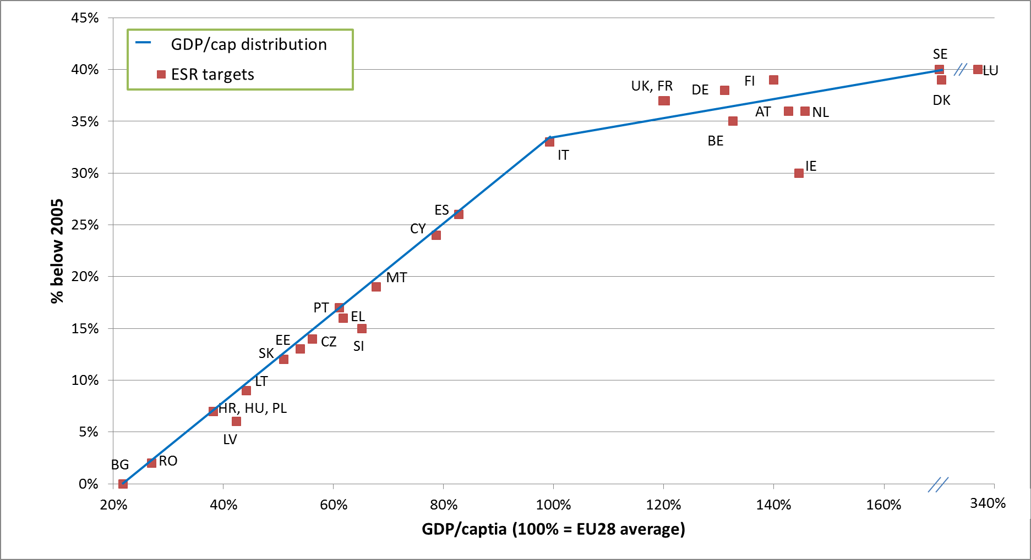
2030 ESR targets by Member State

Slide 4
Flexibilities to achieve ESR targets
Flexibilities affecting total quantity of allowances
LULUCF: MS specific accounting cap, if LULUCF is a net source MS need to compensate
ETS to ESR: 9 MS can shift some allowances from ETS to ESR
Flexibilities not affecting total quantity of allowances
Banking
Borrowing
AEA trade
EU internal project mechanism
No use of international offsets!

Slide 5
Estimating supply and demand
Supply: some uncertainties but relatively clear
2030: target is set
2021 – 2029: annual quantities depend on emissions 2016-2018
Demand: significant uncertainties
Inherent uncertainties in emission projections until 2030
Most MS projections based on 2015 reference year
prior to adoption of EU energy & climate targets
do not include emission development 2016/2017
Maximum use of LULUCF accounting

Slide 6
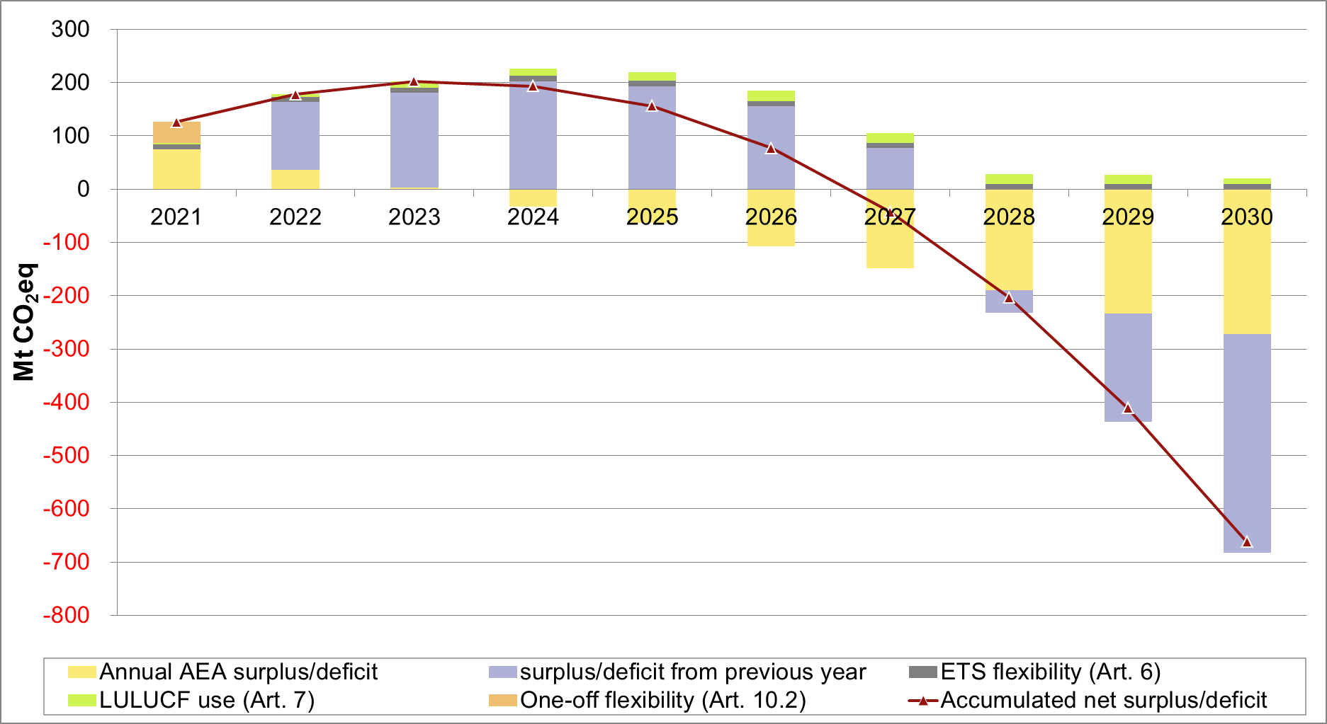
Annual accumulated AEA surplus/demand for the EU-28
Notes: Graph is based on the With Existing Measures Projctions by Member States Sources: Own calculations based on EEA Trends and Projections report 2018 and Öko-Institut 2017

Slide 7
Supply and demand by MS
EU-28: Accumulated surplus between +50 and -1100 M AEA until 2030
Countries with net surplus (potential sellers)
Bulgaria, Croatia, Greece, Hungary, Portugal, Slovakia, Slovenia and Sweden
100-300 M AEA surplus until 2030
Countries with net demand (potential buyers)
Austria, Belgium, Cyprus, Denmark, France, Germany, Ireland, Italy, Luxembourg and Poland
350 – 1 000 M AEA deficit until 2030
Other Member States: potential buyers or sellers depending on projection used

Slide 8
AEA trade
Actors
Tradig takes place between Member States only (no private entities)
Few actors, very different market power
MS will need to decide on mechanism
Bilateral agreements
Auctions
Regulation allows for market intermediaries
Transparency
No obligation to publish agreed price or conditions
Public reporting of emissions (yearly) and projections (every two years)

Slide 9
AEA price considerations
Potential indicators
Other AEA deals (if public)
Carbon taxes in Europe (50-125 €/t CO₂)
Marginal abatement cost curves
EU ETS price as lower bound
Minimum price under the ESR due to ETS->ESR flexiblity
Low hanging fruits (large points sources, energy sector) are in the ETS; abatement costs in the housing, transport & agriculture sectors tend to be higher.
International carbon prices not applicable
ITMOs and CORSIA units cannot be used (no direct link)
Quality standards expected to be much lower and very different conditions in many participating countries (no indirect link)

Slide 10
Any Questions?
Jakob Graichen Senior Researcher, Öko-Institut j.graichen@oeko.de

